Slide 1
WCNPO Striped Marlin Rebuilding Scenarios Using 2020 Catch Proportions by Fleet Group
Jon Brodziak
NOAA Fisheries
Jon.Brodziak@NOAA.GOV

Slide 2
CMM 2024-06 Revision to CMM 2010-01 for NP MLS
Country | Catch Limit
Japan | 1454.4mt
Chinese Taipei | 358.4mt
Korea | 214.8mt
United States | 228.4mt
China | 68.8 mt
Other SIDS | 75.2 mt
Total | 2400 mt
Maximum catch limit of 2400 mt
In 2025-2027, each country can take up to 165 mt additional to their individual limit if the catch limit in 2023-2025 is not reached
In 2023 there was an underage of 826mt therefore countries are allowed to increase their limit by 165mt in 2025.
Any underage in 2024 can be applied to 2026, and 2025 to 2027.
No country is allowed to increase their catch by more than 165 mt.
If underage is less than 826 mt, then there will be decisions made about who gets that extra catch (not our problem)
Overage for each country is subtracted from their next year’s individual limit

Slide 3
Scenario 1. CMM 2024-06 Catch Limits
Country | 2025 | 2026 | 2027
Japan | 1454.4 mt | 1454.4 mt | 1454.4 mt
Chinese Taipei | 358.4 mt | 358.4 mt | 358.4 mt
Korea | 214.8 mt | 214.8 mt | 214.8 mt
United States | 228.4 mt | 228.4 mt | 228.4 mt
China | 68.8 mt | 68.8 mt | 68.8 mt
Other SIDS | 75.2 mt | 75.2 mt | 75.2 mt
Total | 2400 mt | 2400 mt | 2400 mt
For countries which are represented by more than one fleet in the rebuilding analysis, catch would be distributed between fleets based upon the proportion of catch for each fleet in 2020 (last year of the assessment)
For 2021-2022, catch would be updated to reported (yearbook catch) from WCPFC, and 2023-2024 would be carryover catch from 2022 if updated catch is not available.

Slide 4
Scenario 2. CMM 2024-06 Catch Limits with 2025 Carryover
Country | 2025 | 2026 | 2027
Japan | 1454.4 mt + 165 mt | 1454.4 mt | 1454.4 mt
Chinese Taipei | 358.4mt + 165 mt | 358.4 mt | 358.4 mt
Korea | 214.8mt + 165 mt | 214.8 mt | 214.8 mt
United States | 228.4mt + 165 mt | 228.4 mt | 228.4 mt
China | 68.8 mt + 165 mt | 68.8 mt | 68.8 mt
Other SIDS | 75.2 mt | 75.2 mt | 75.2 mt
Total | 3225 mt | 2400 mt | 2400 mt
For countries which are represented by more than one fleet in the rebuilding analysis, catch would be distributed between fleets based upon the proportion of catch for each fleet in 2020 (last year of the assessment)
For 2021-2022, catch would be updated to reported (yearbook catch) from WCPFC, and 2023-2024 would be carryover catch from 2022 if updated catch is not available.
.

Slide 5
Scenario 3. CMM 2024-06 Catch Limits and 2025-2026 Carryover
Country | 2025 | 2026 | 2027
Japan | 1454.4 mt + 165 mt | 1454.4 mt + 165 mt | 1454.4 mt
Chinese Taipei | 358.4 mt + 165 mt | 358.4 mt + 165 mt | 358.4 mt
Korea | 214.8 mt + 165 mt | 214.8 mt + 165 mt | 214.8 mt
United States | 228.4 mt + 165 mt | 228.4 mt + 165 mt | 228.4 mt
China | 68.8 mt + 165 mt | 68.8 mt + 165mt | 68.8 mt
Other SIDS | 75.2 mt | 75.2 mt | 75.2 mt
Total | 3225 mt | 3225 mt | 2400 mt
For countries which are represented by more than one fleet in the rebuilding analysis, catch would be distributed between fleets based upon the proportion of catch for each fleet in 2020 (last year of the assessment)
For 2021-2022, catch would be updated to reported (yearbook catch) from WCPFC, and 2023-2024 would be carryover catch from 2022 if updated catch is not available.

Slide 6
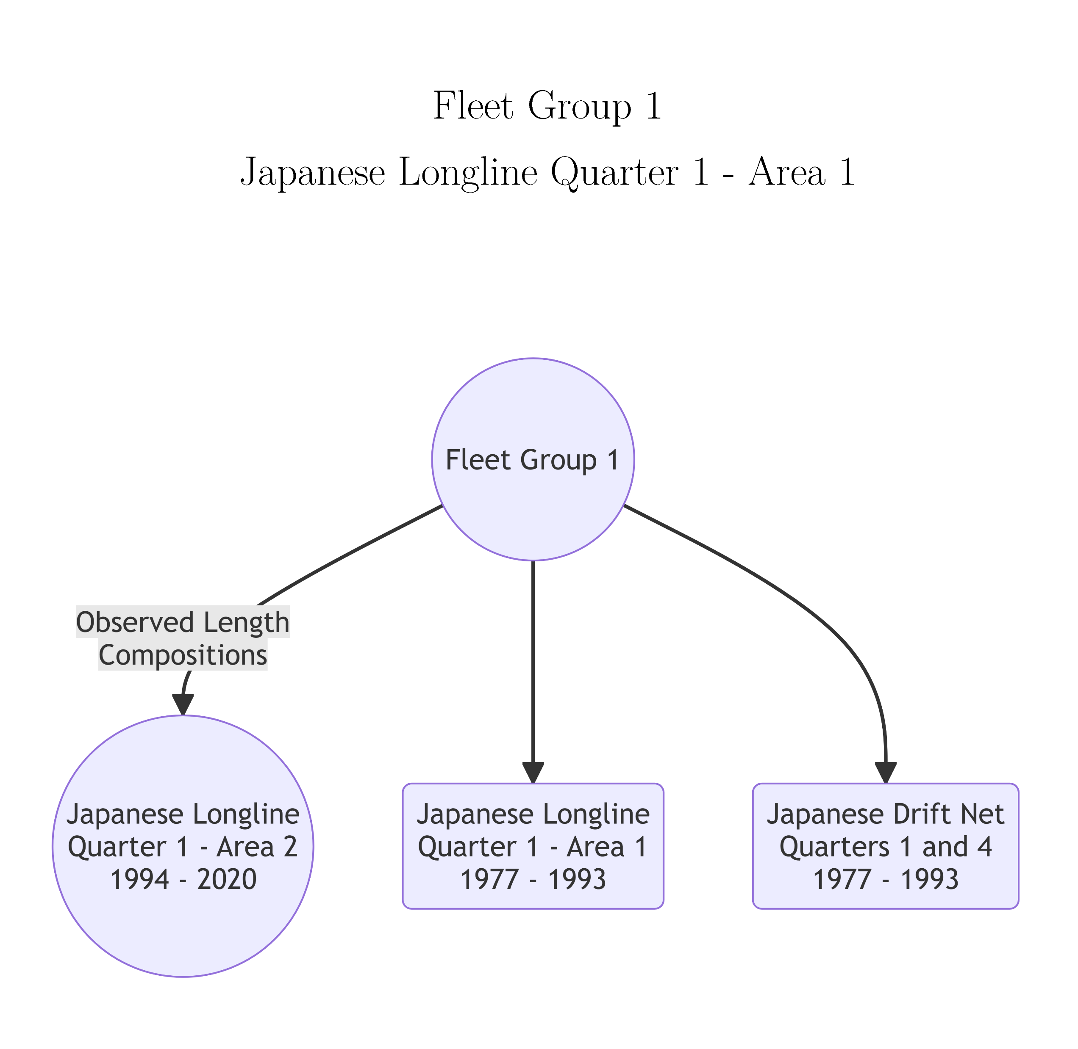
Fleet Groups with Identical Fishery Selectivity for Striped Marlin

Slide 7
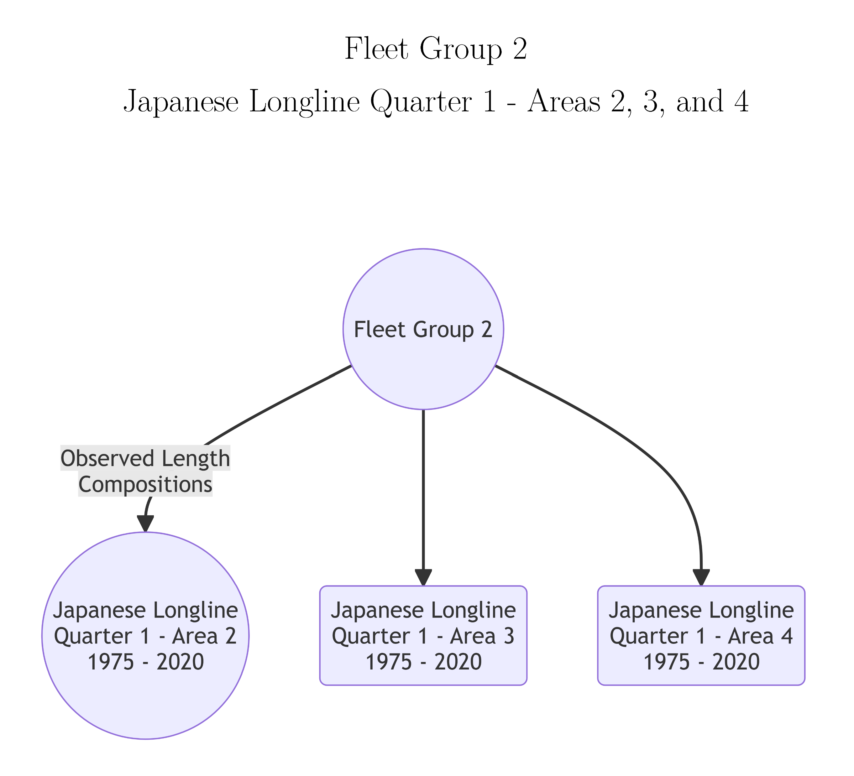
Fleet Groups with Identical Fishery Selectivity for Striped Marlin

Slide 8
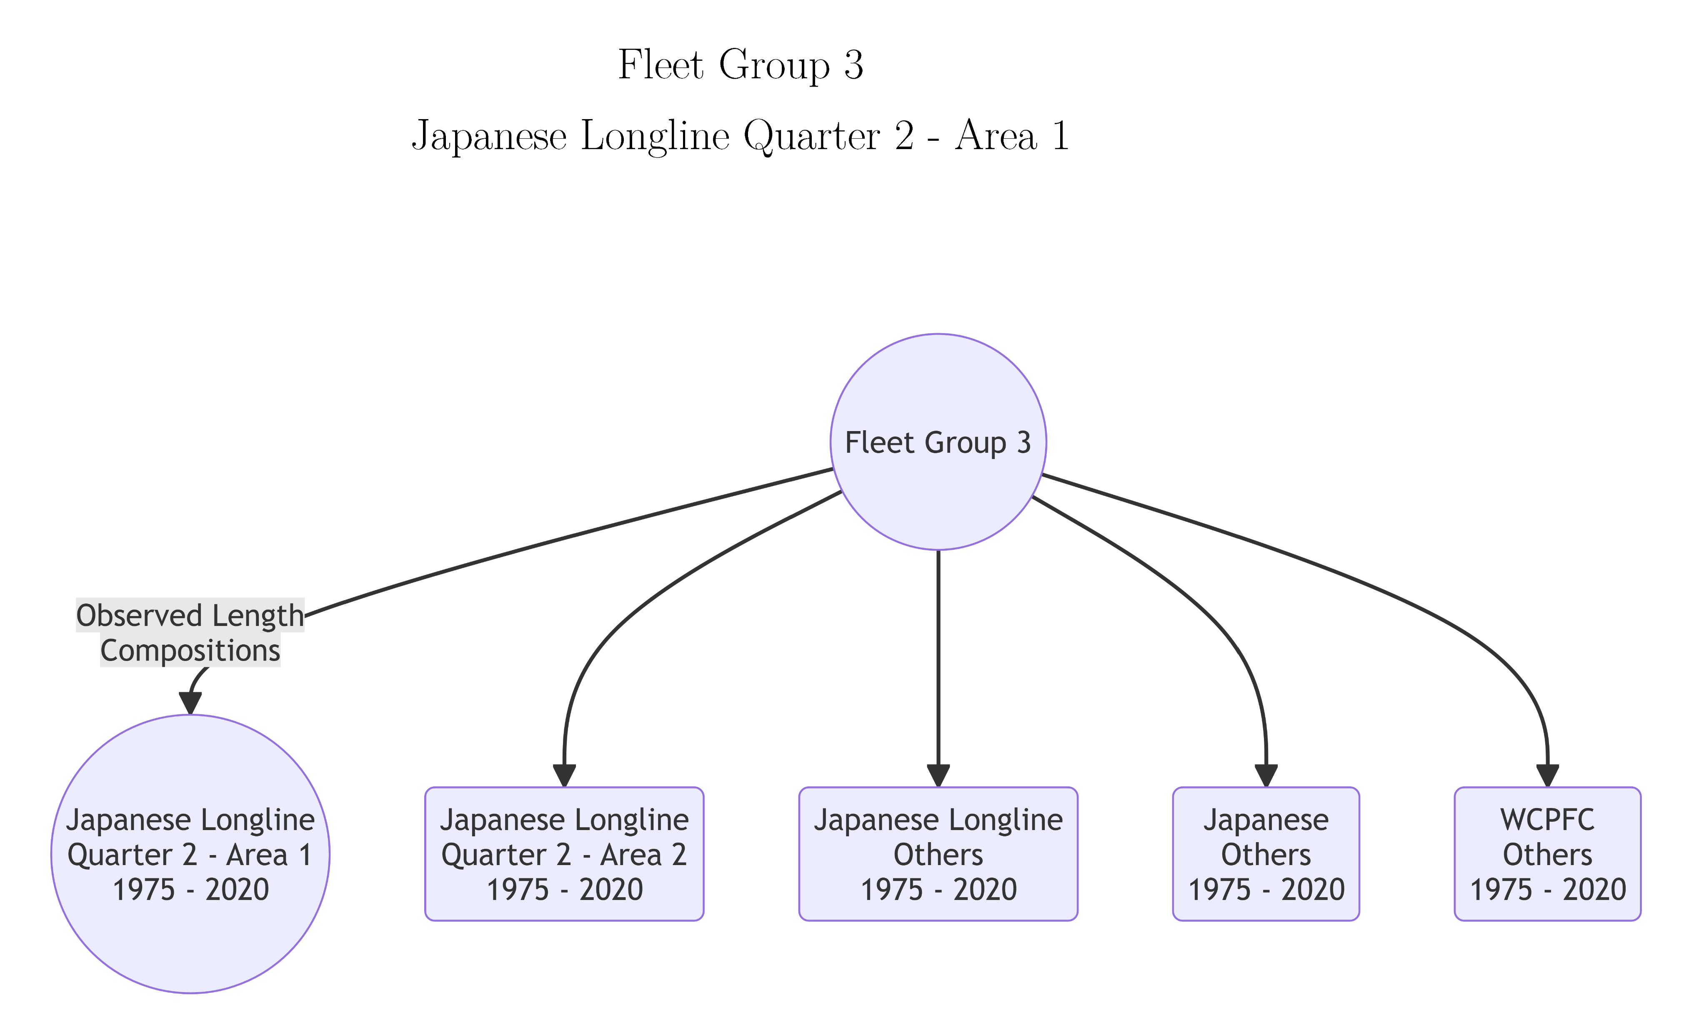
Fleet Groups with Identical Fishery Selectivity for Striped Marlin

Slide 9
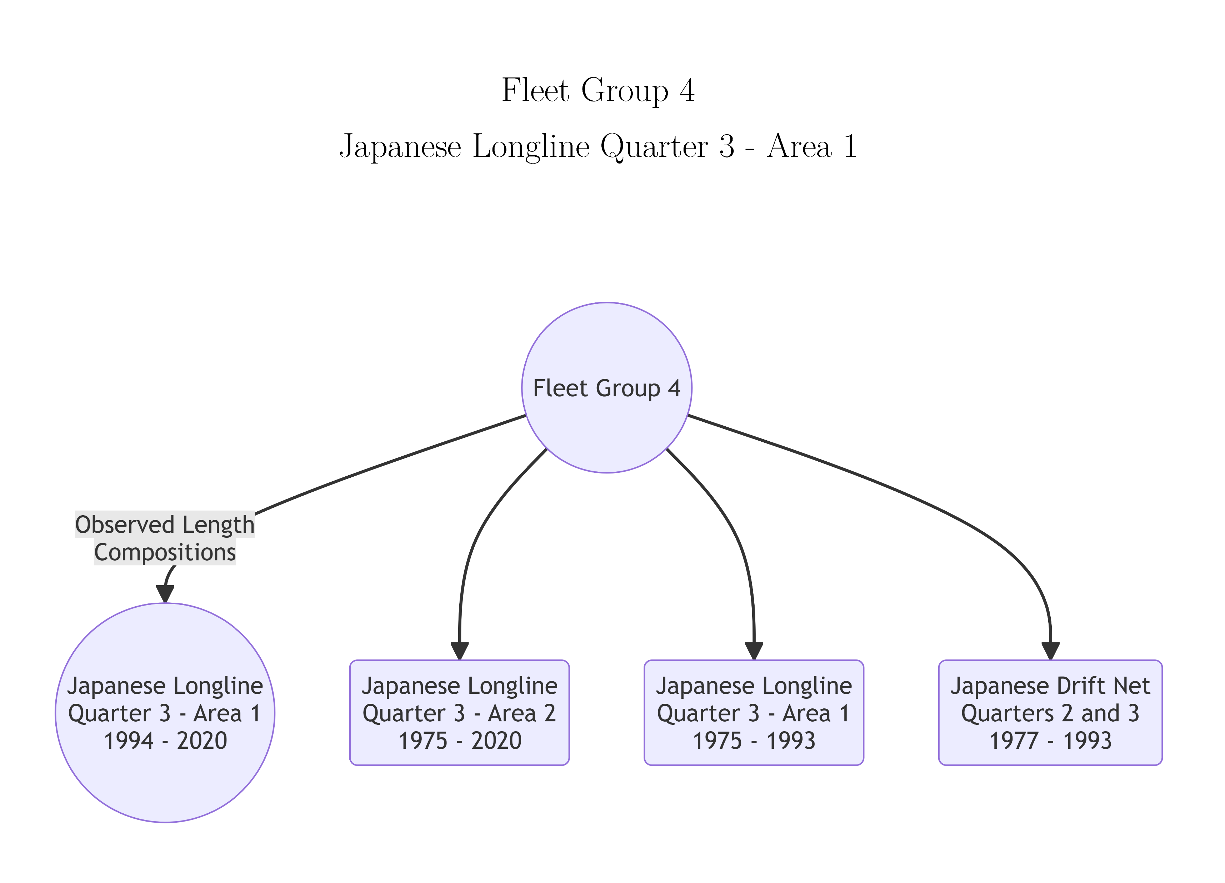
Fleet Groups with Identical Fishery Selectivity for Striped Marlin

Slide 10
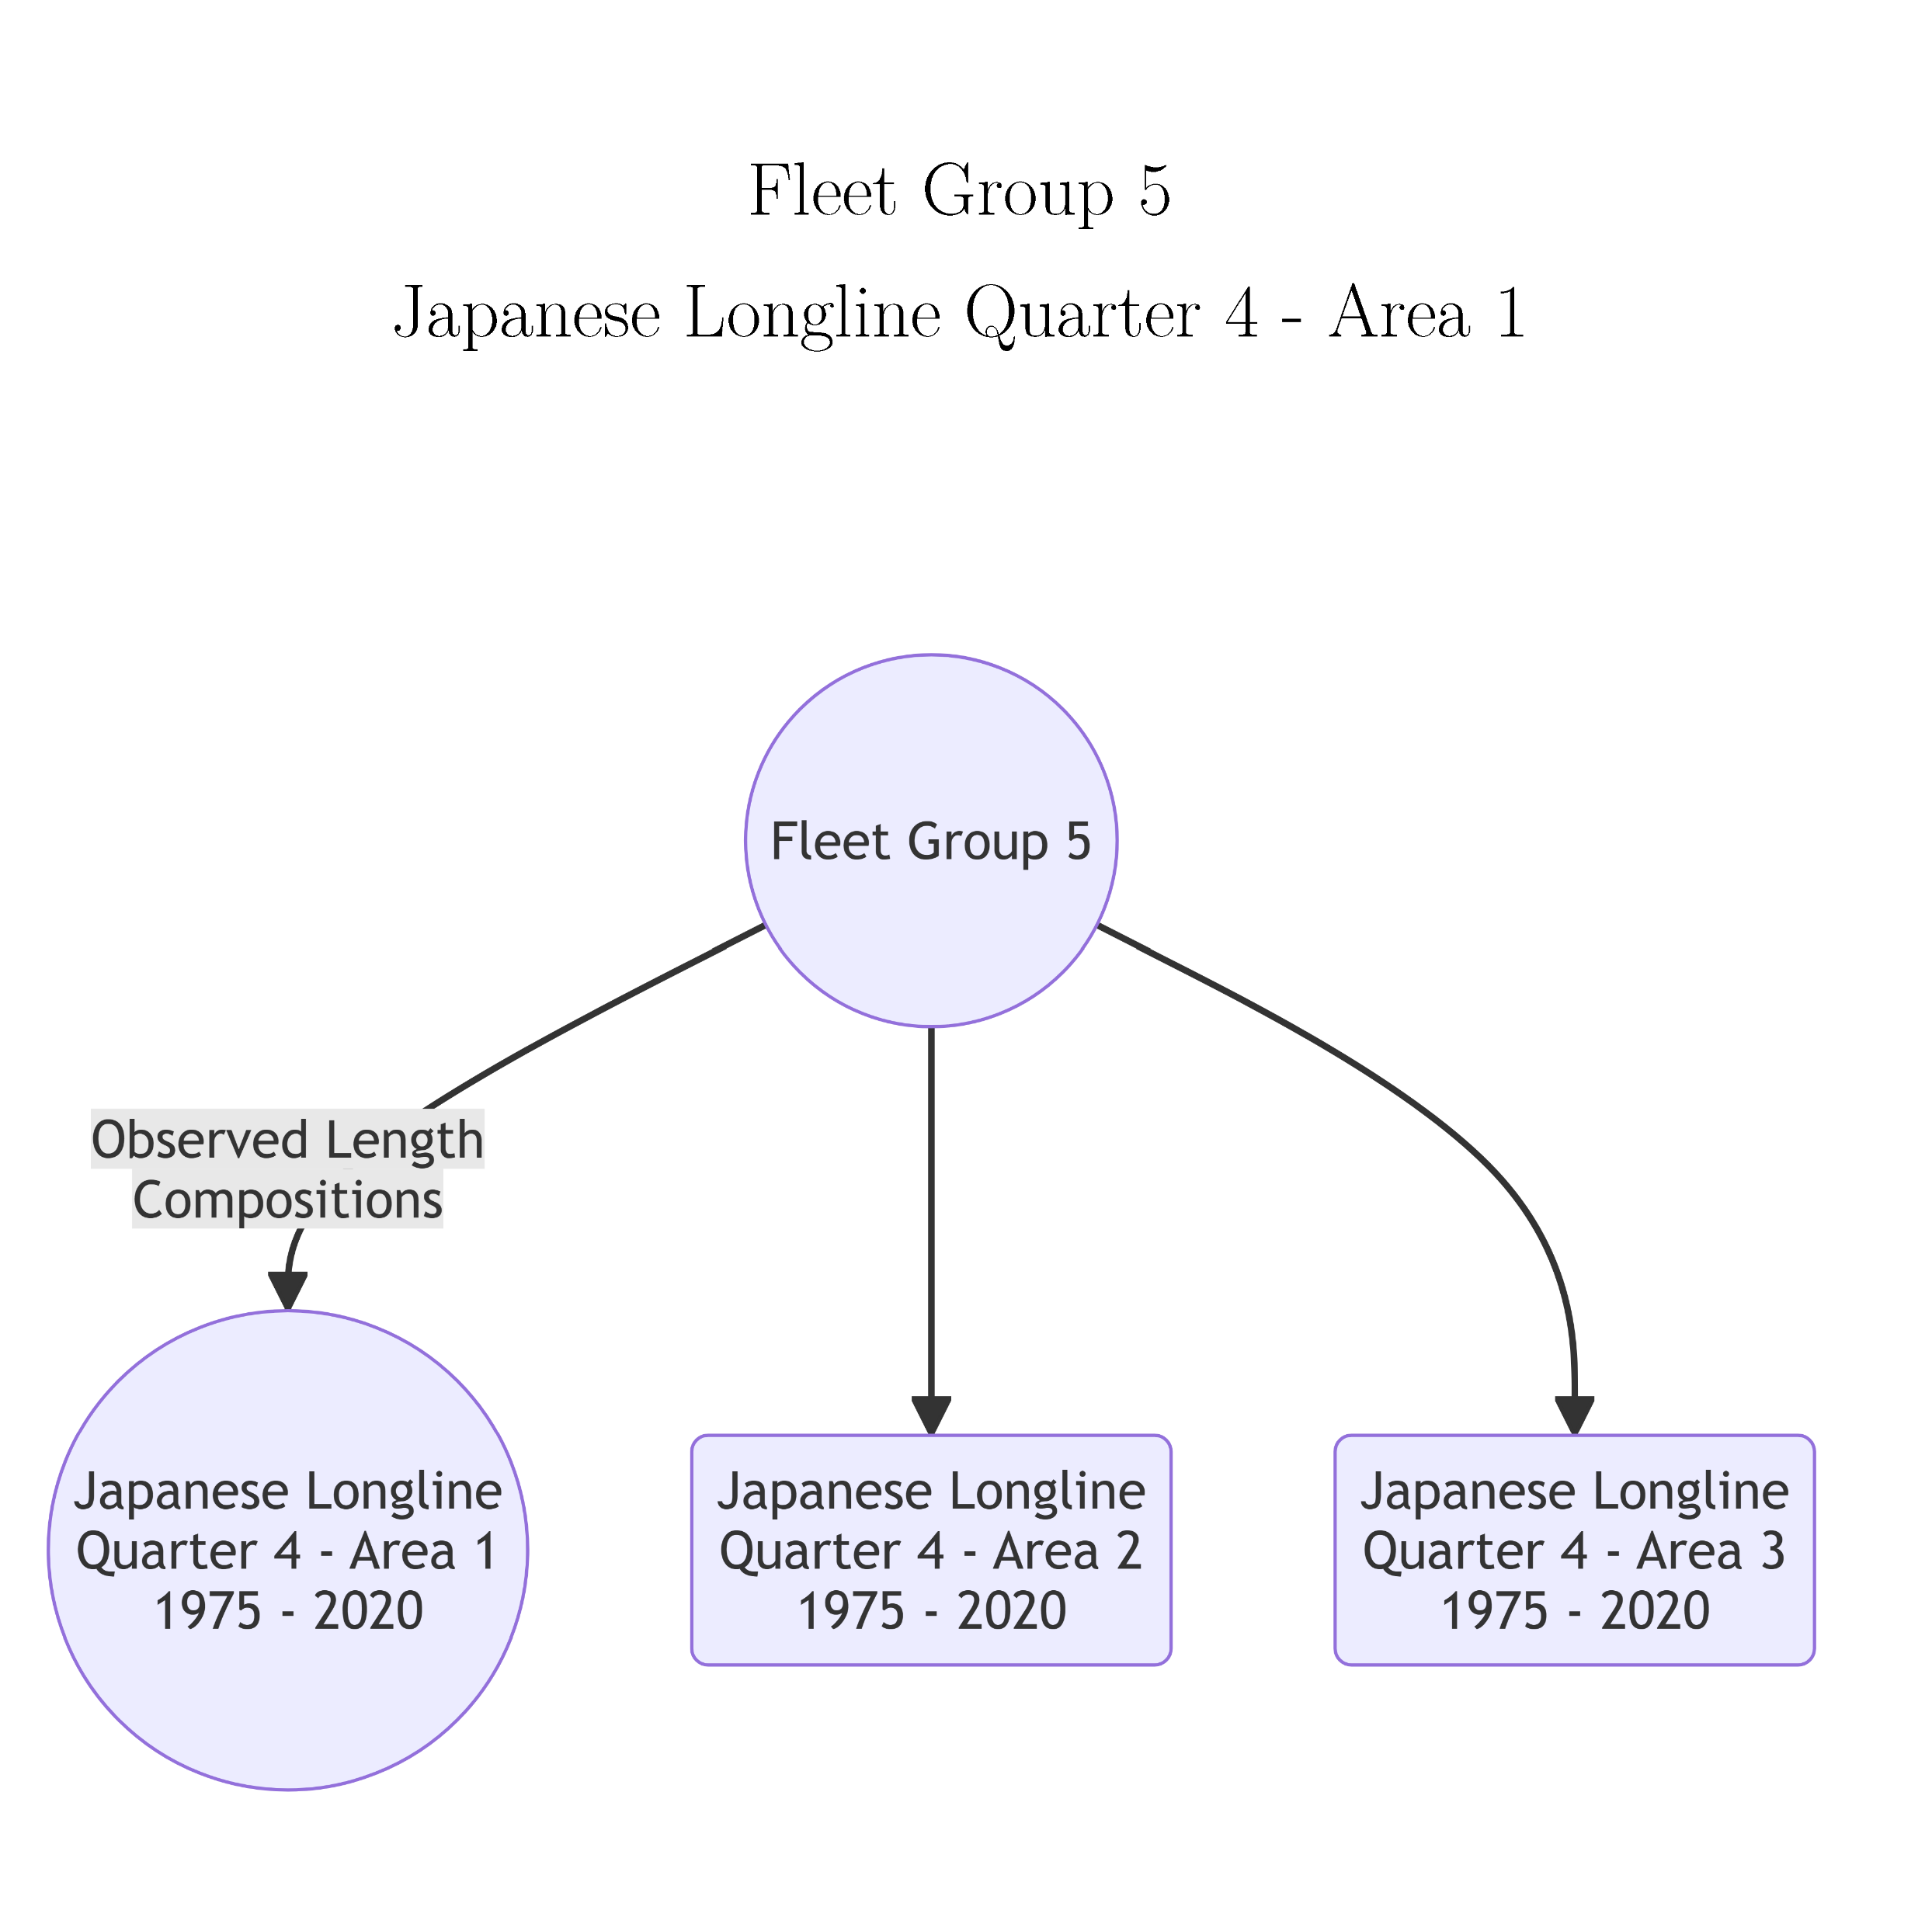
Fleet Groups with Identical Fishery Selectivity for Striped Marlin

Slide 11
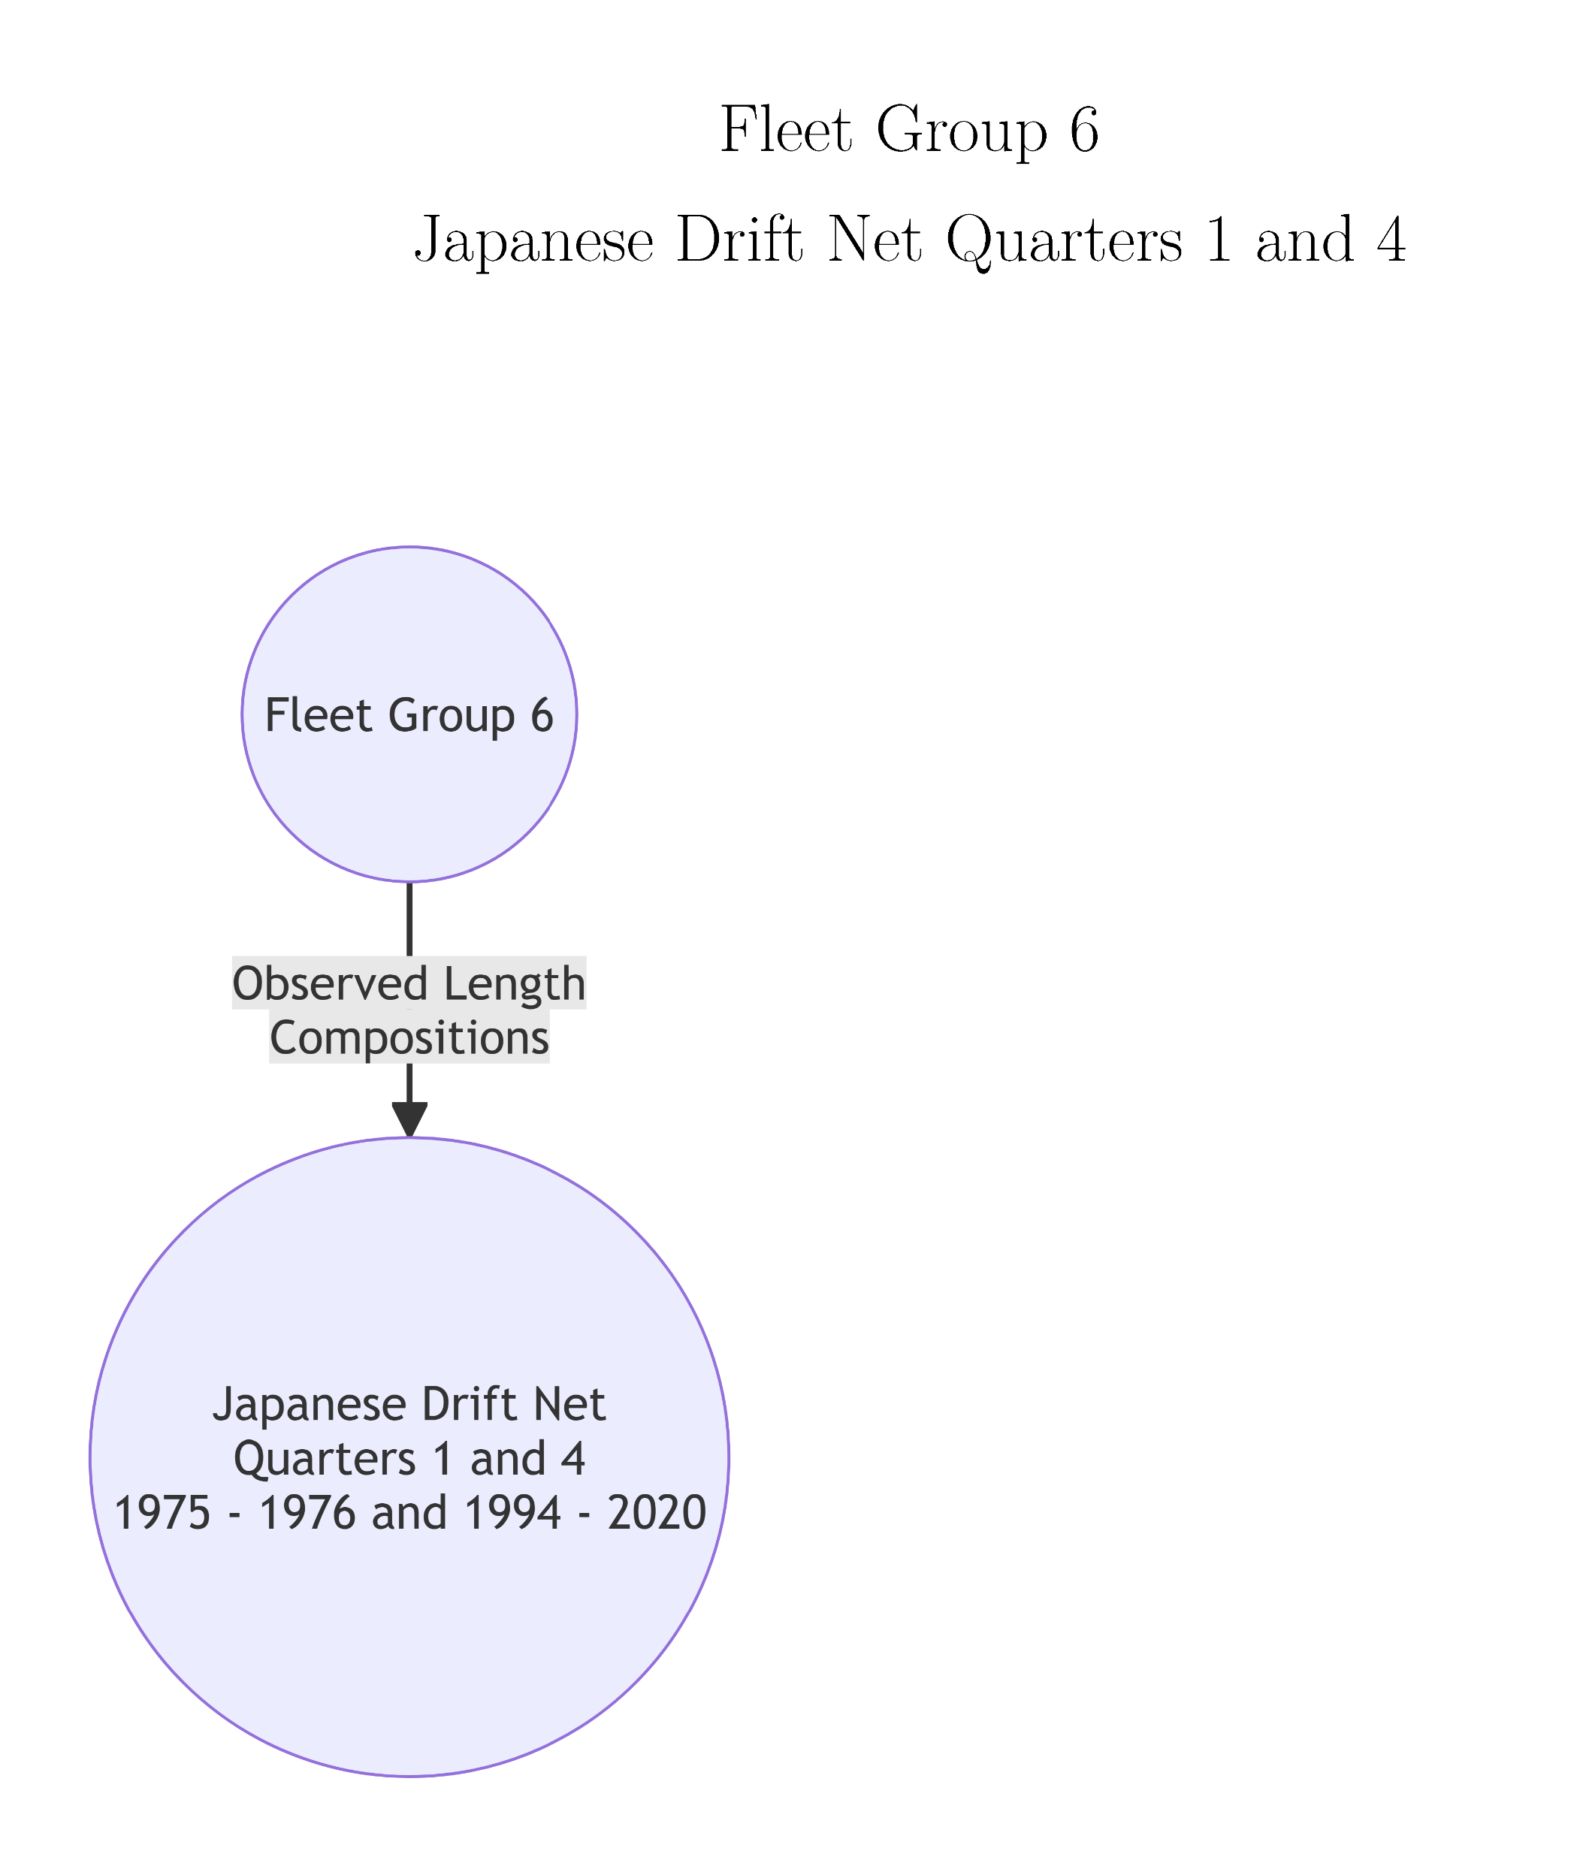
Fleet Groups with Identical Fishery Selectivity for Striped Marlin

Slide 12
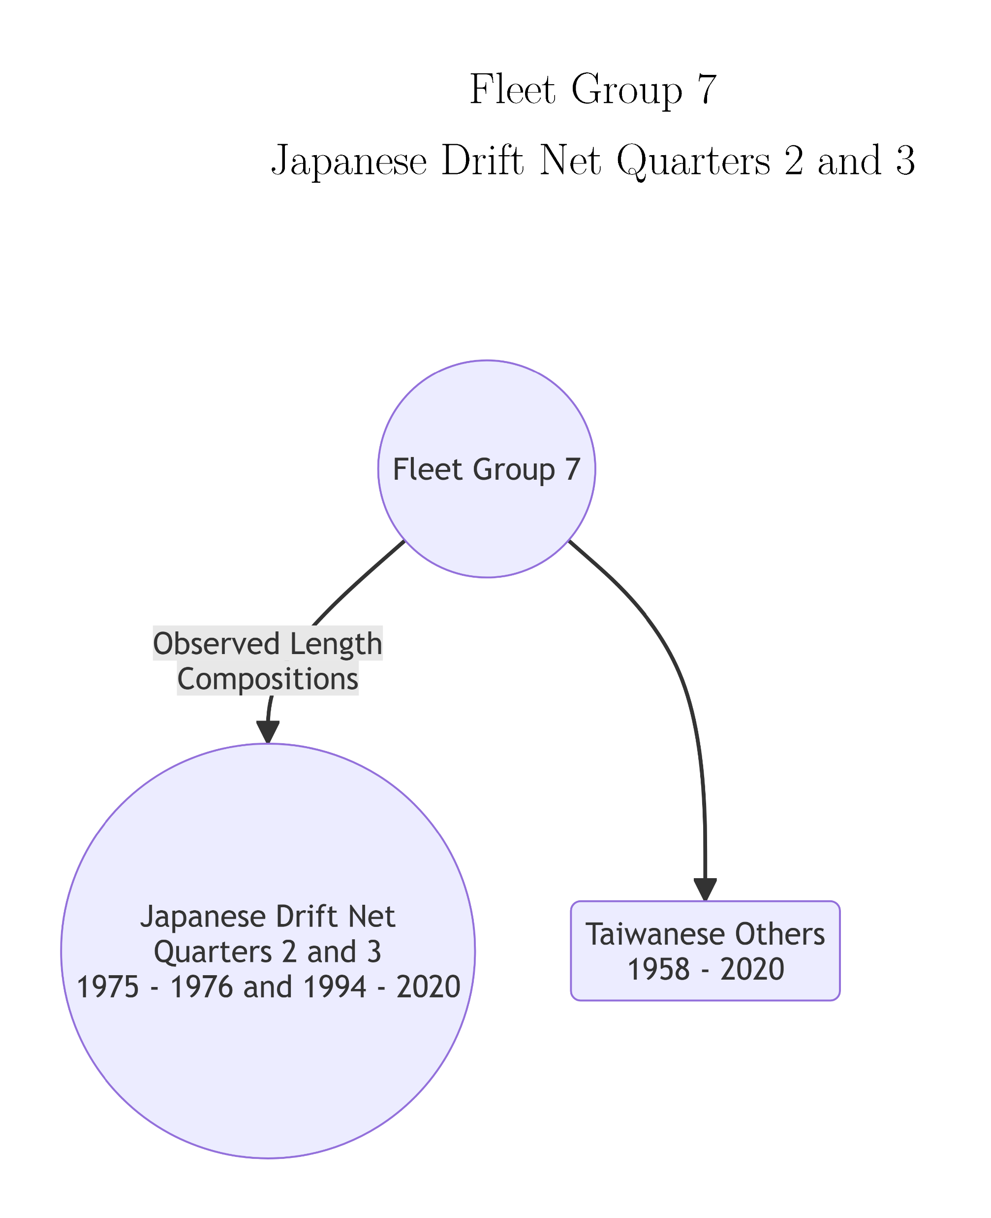
Fleet Groups with Identical Fishery Selectivity for Striped Marlin

Slide 13
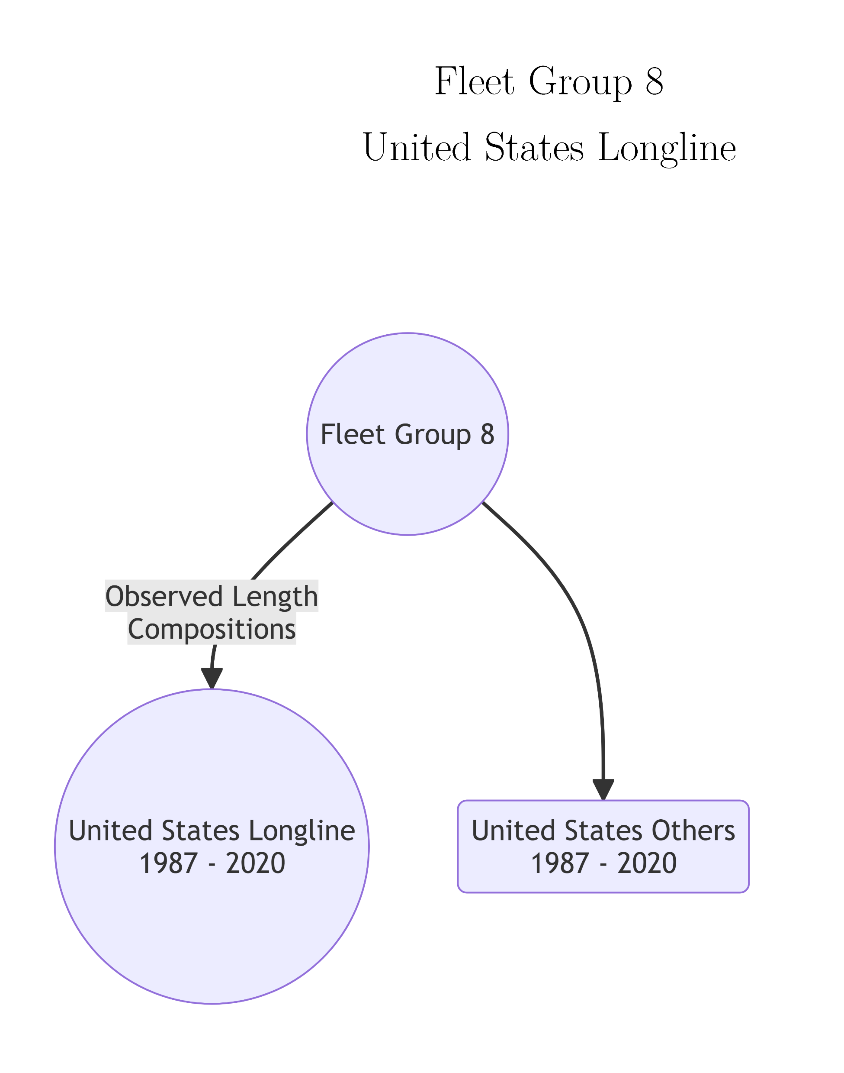
Fleet Groups with Identical Fishery Selectivity for Striped Marlin

Slide 14
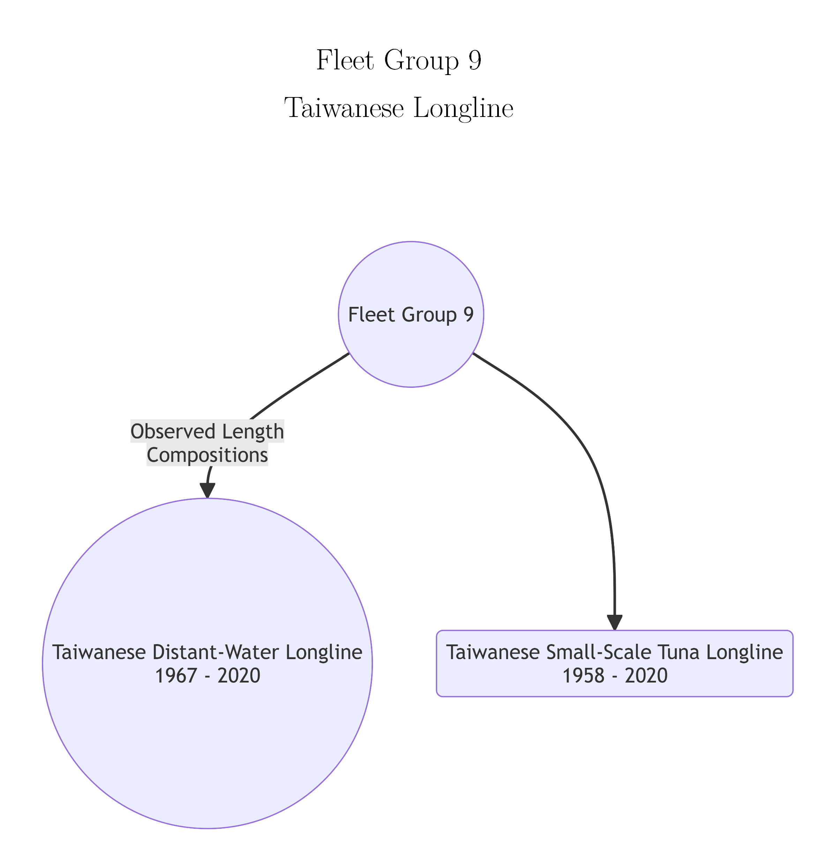
Fleet Groups with Identical Fishery Selectivity for Striped Marlin

Slide 15
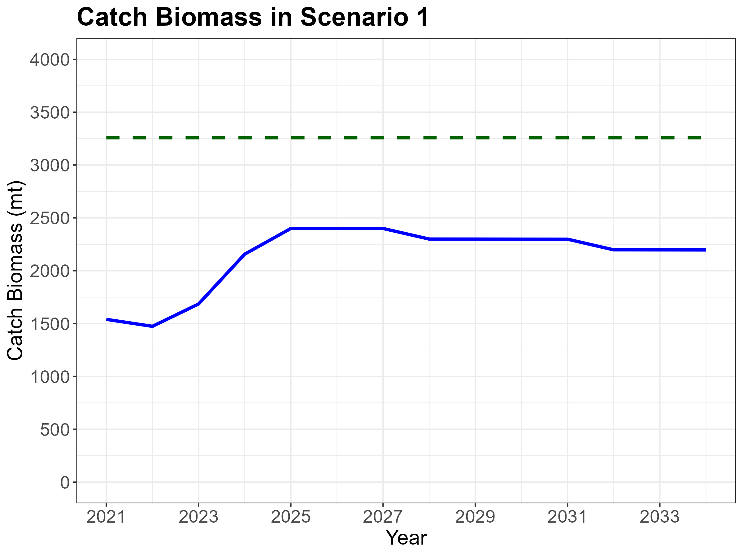

Slide 16
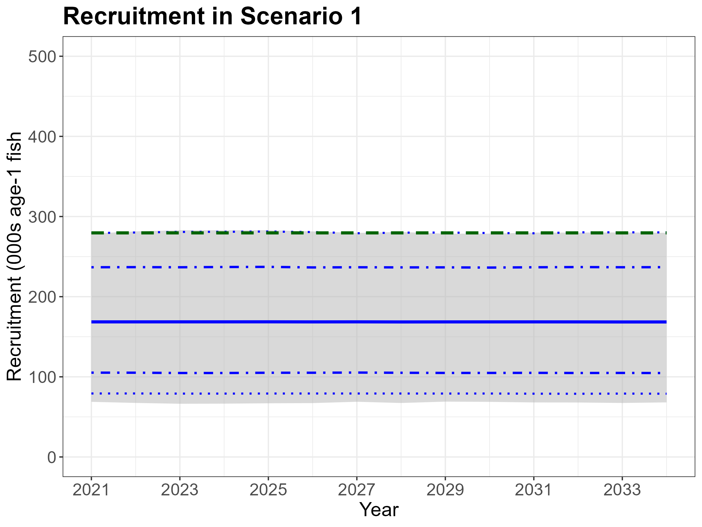

Slide 17
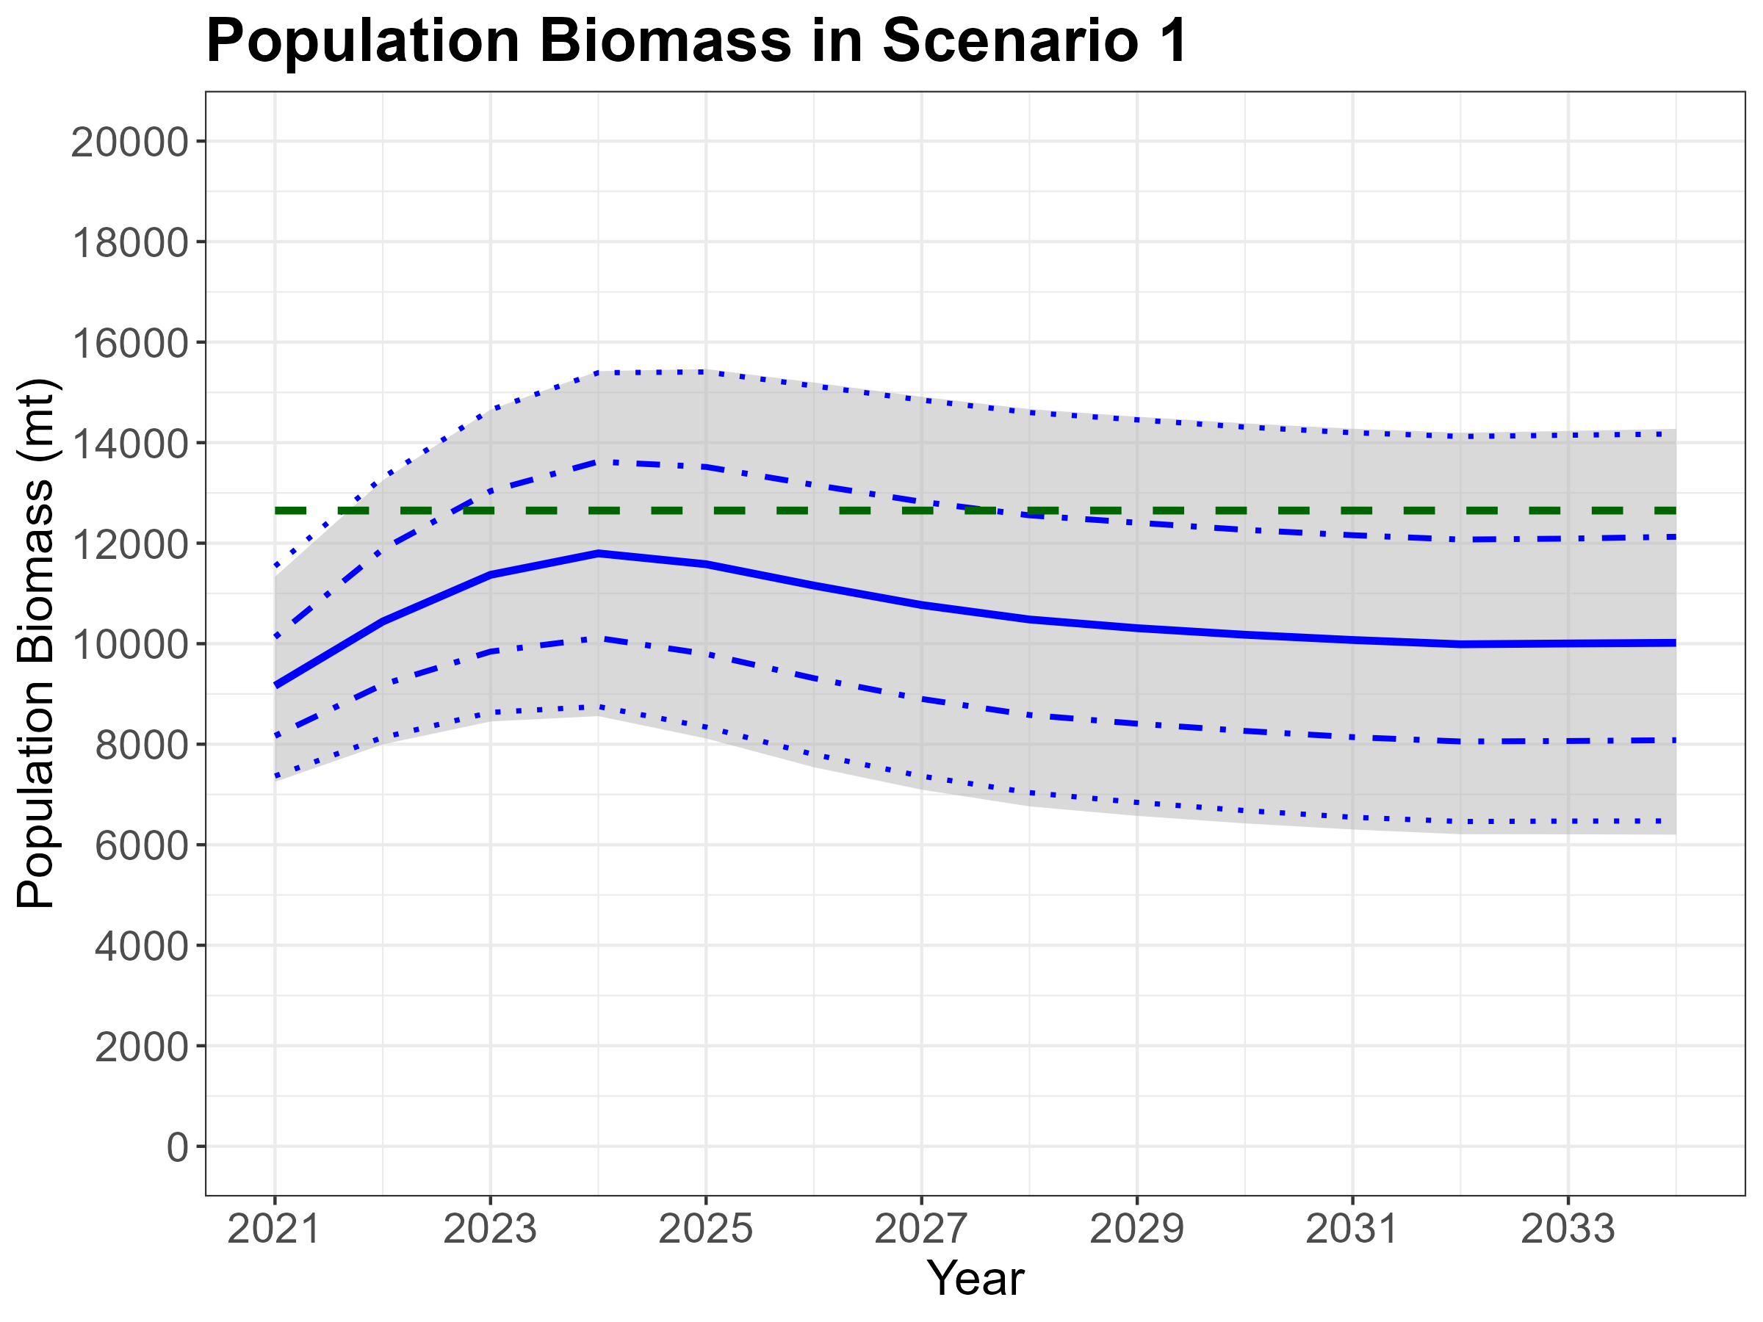

Slide 18
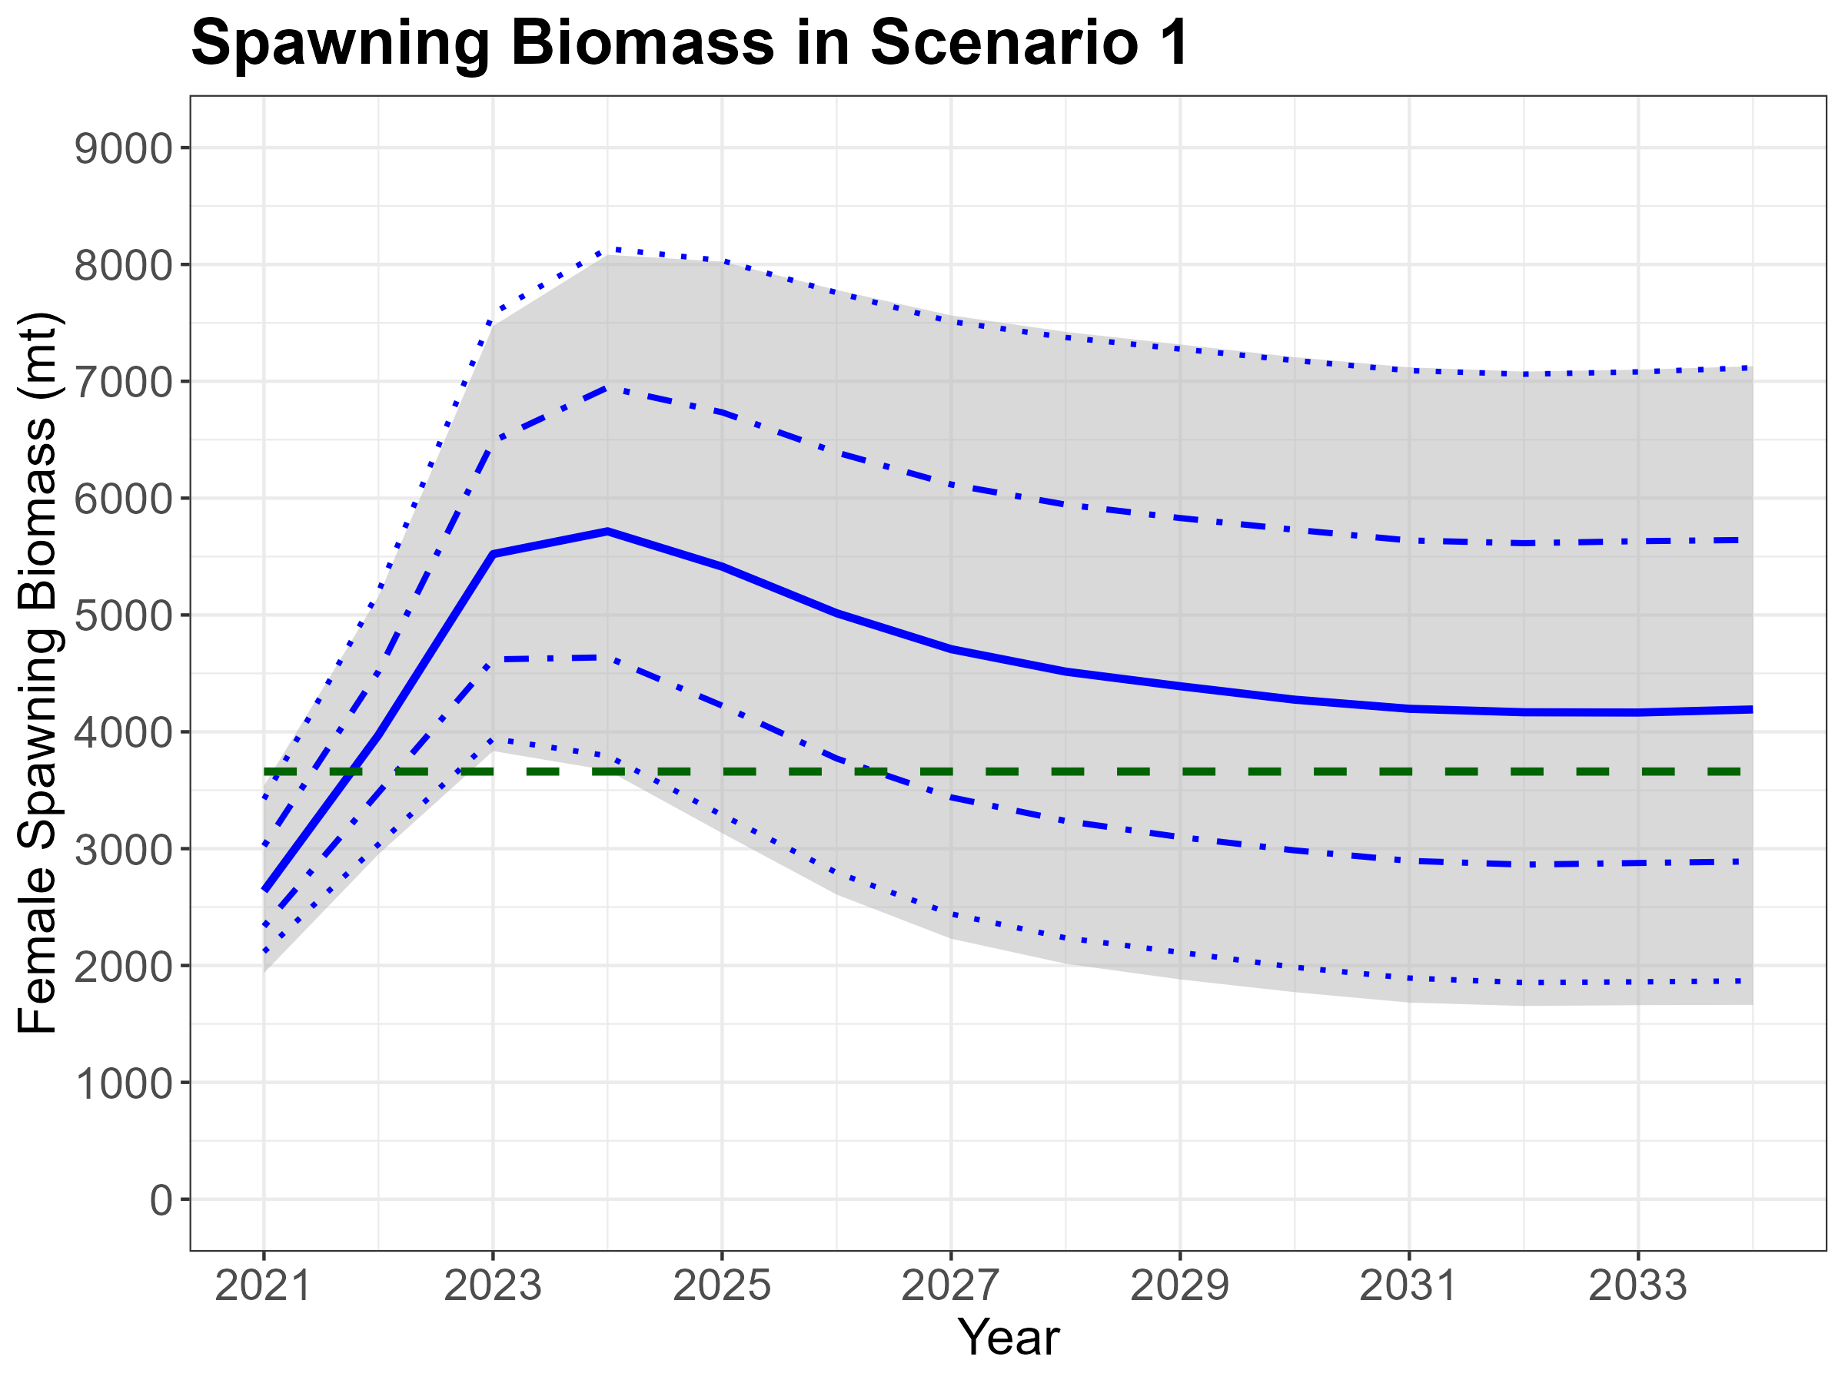

Slide 19
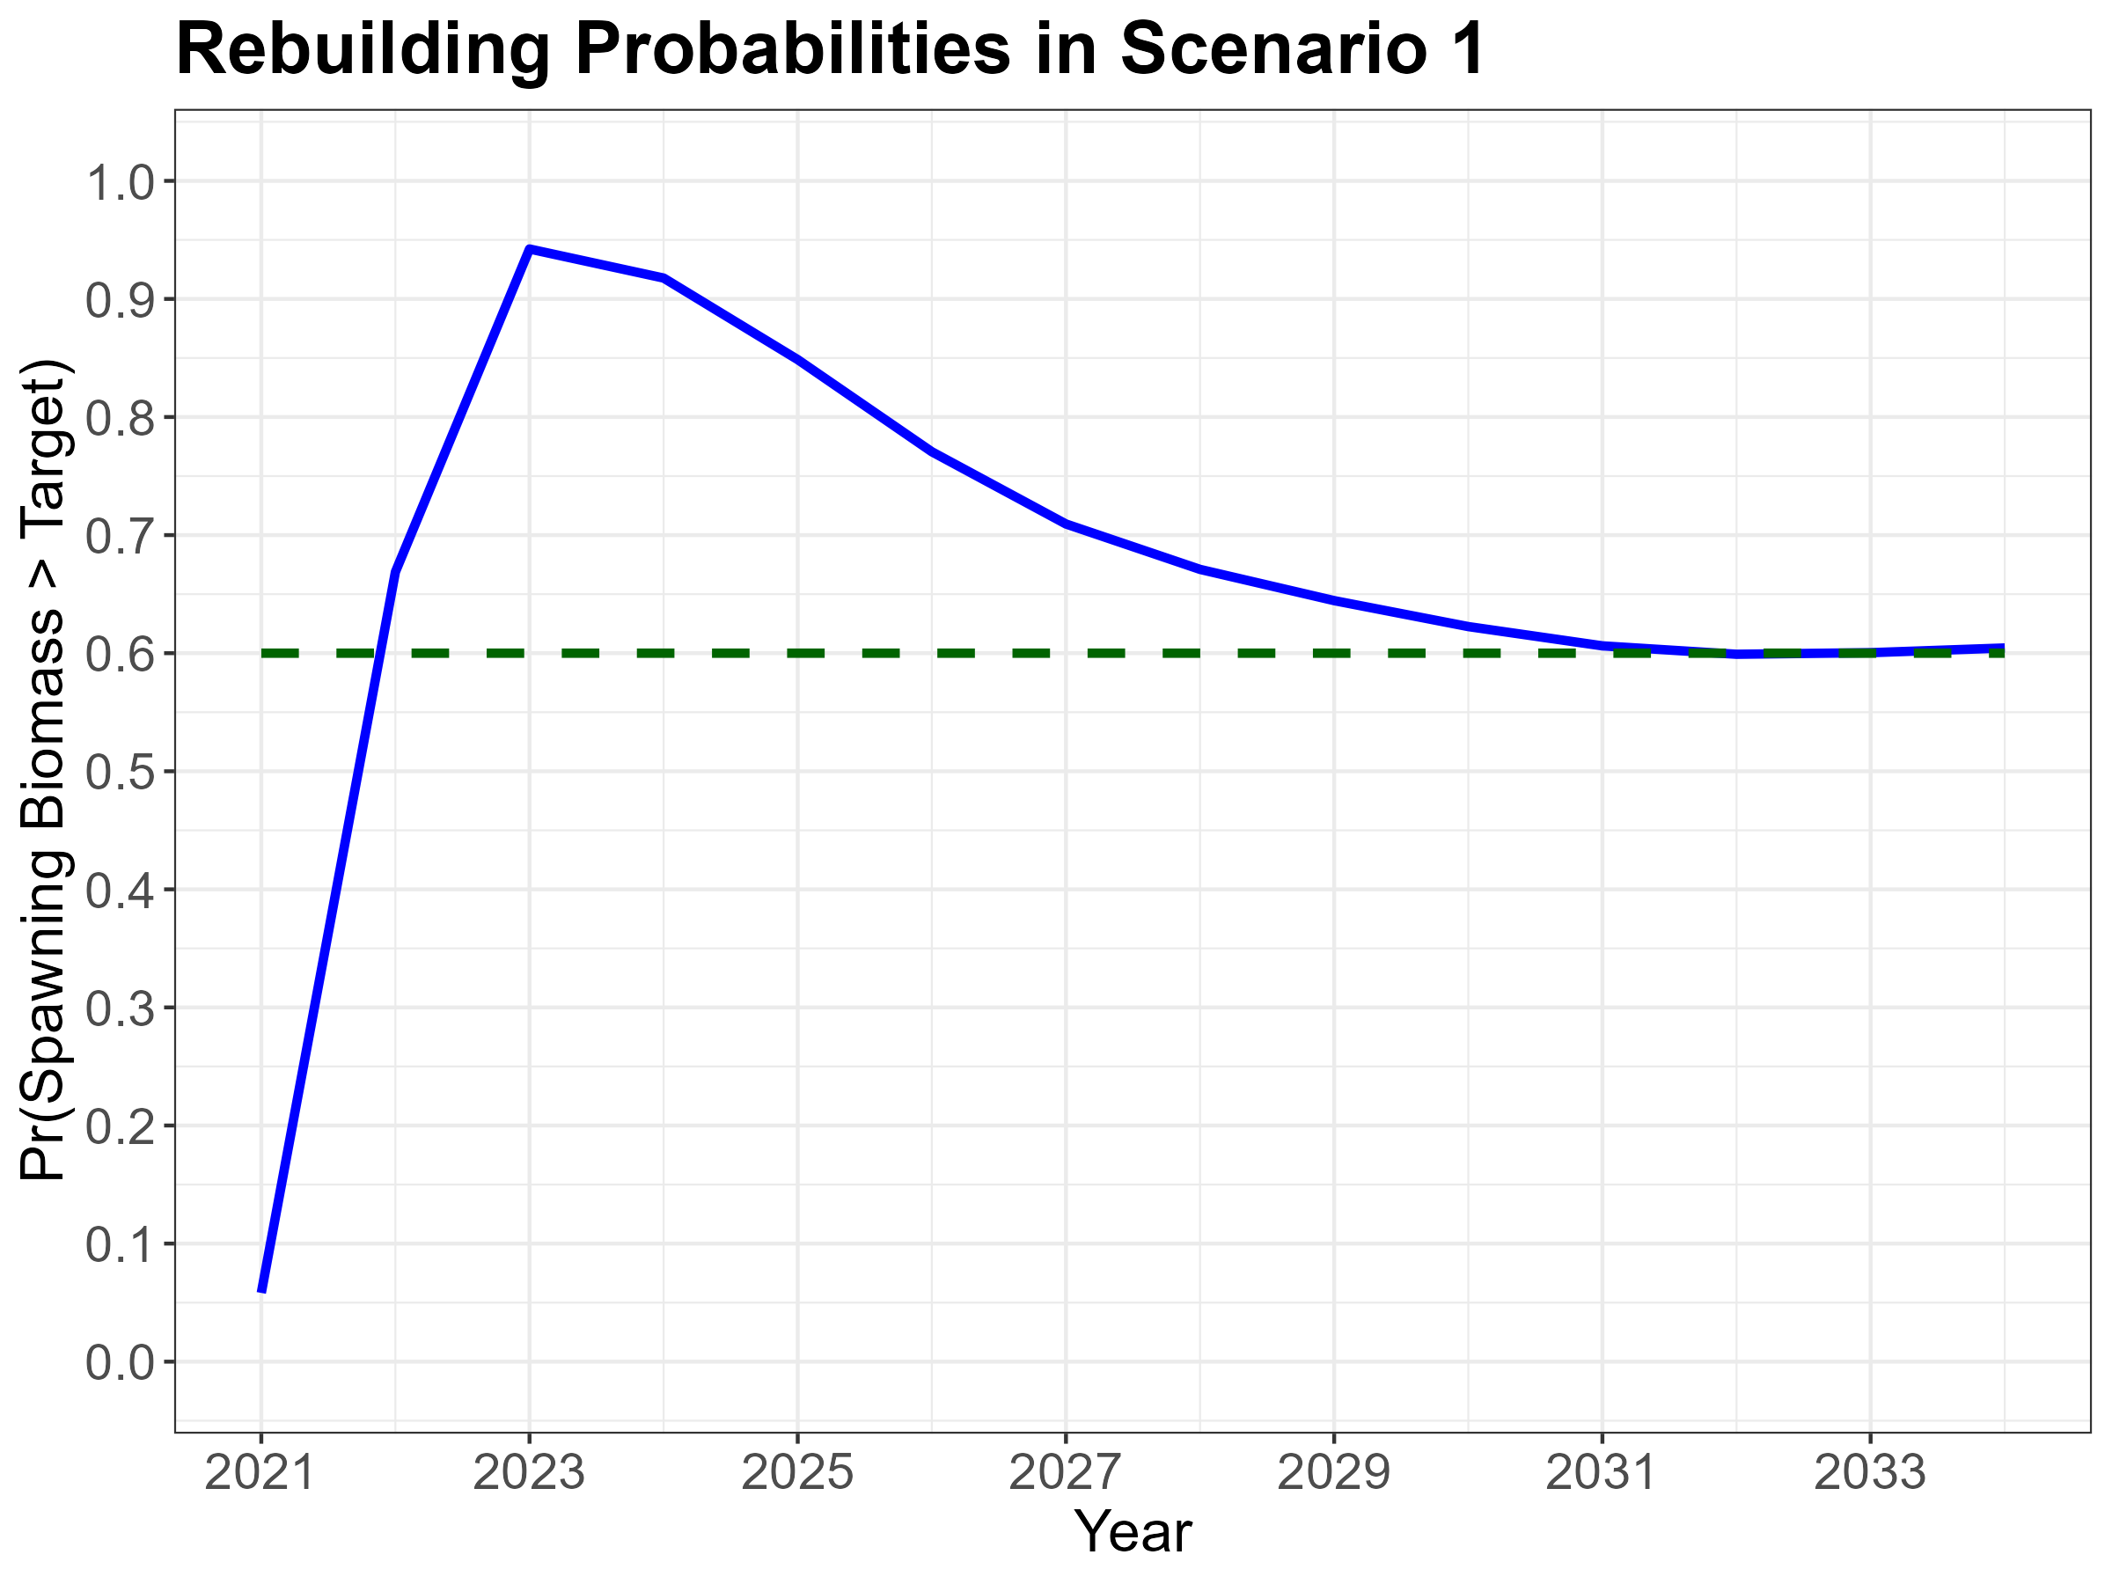

Slide 21
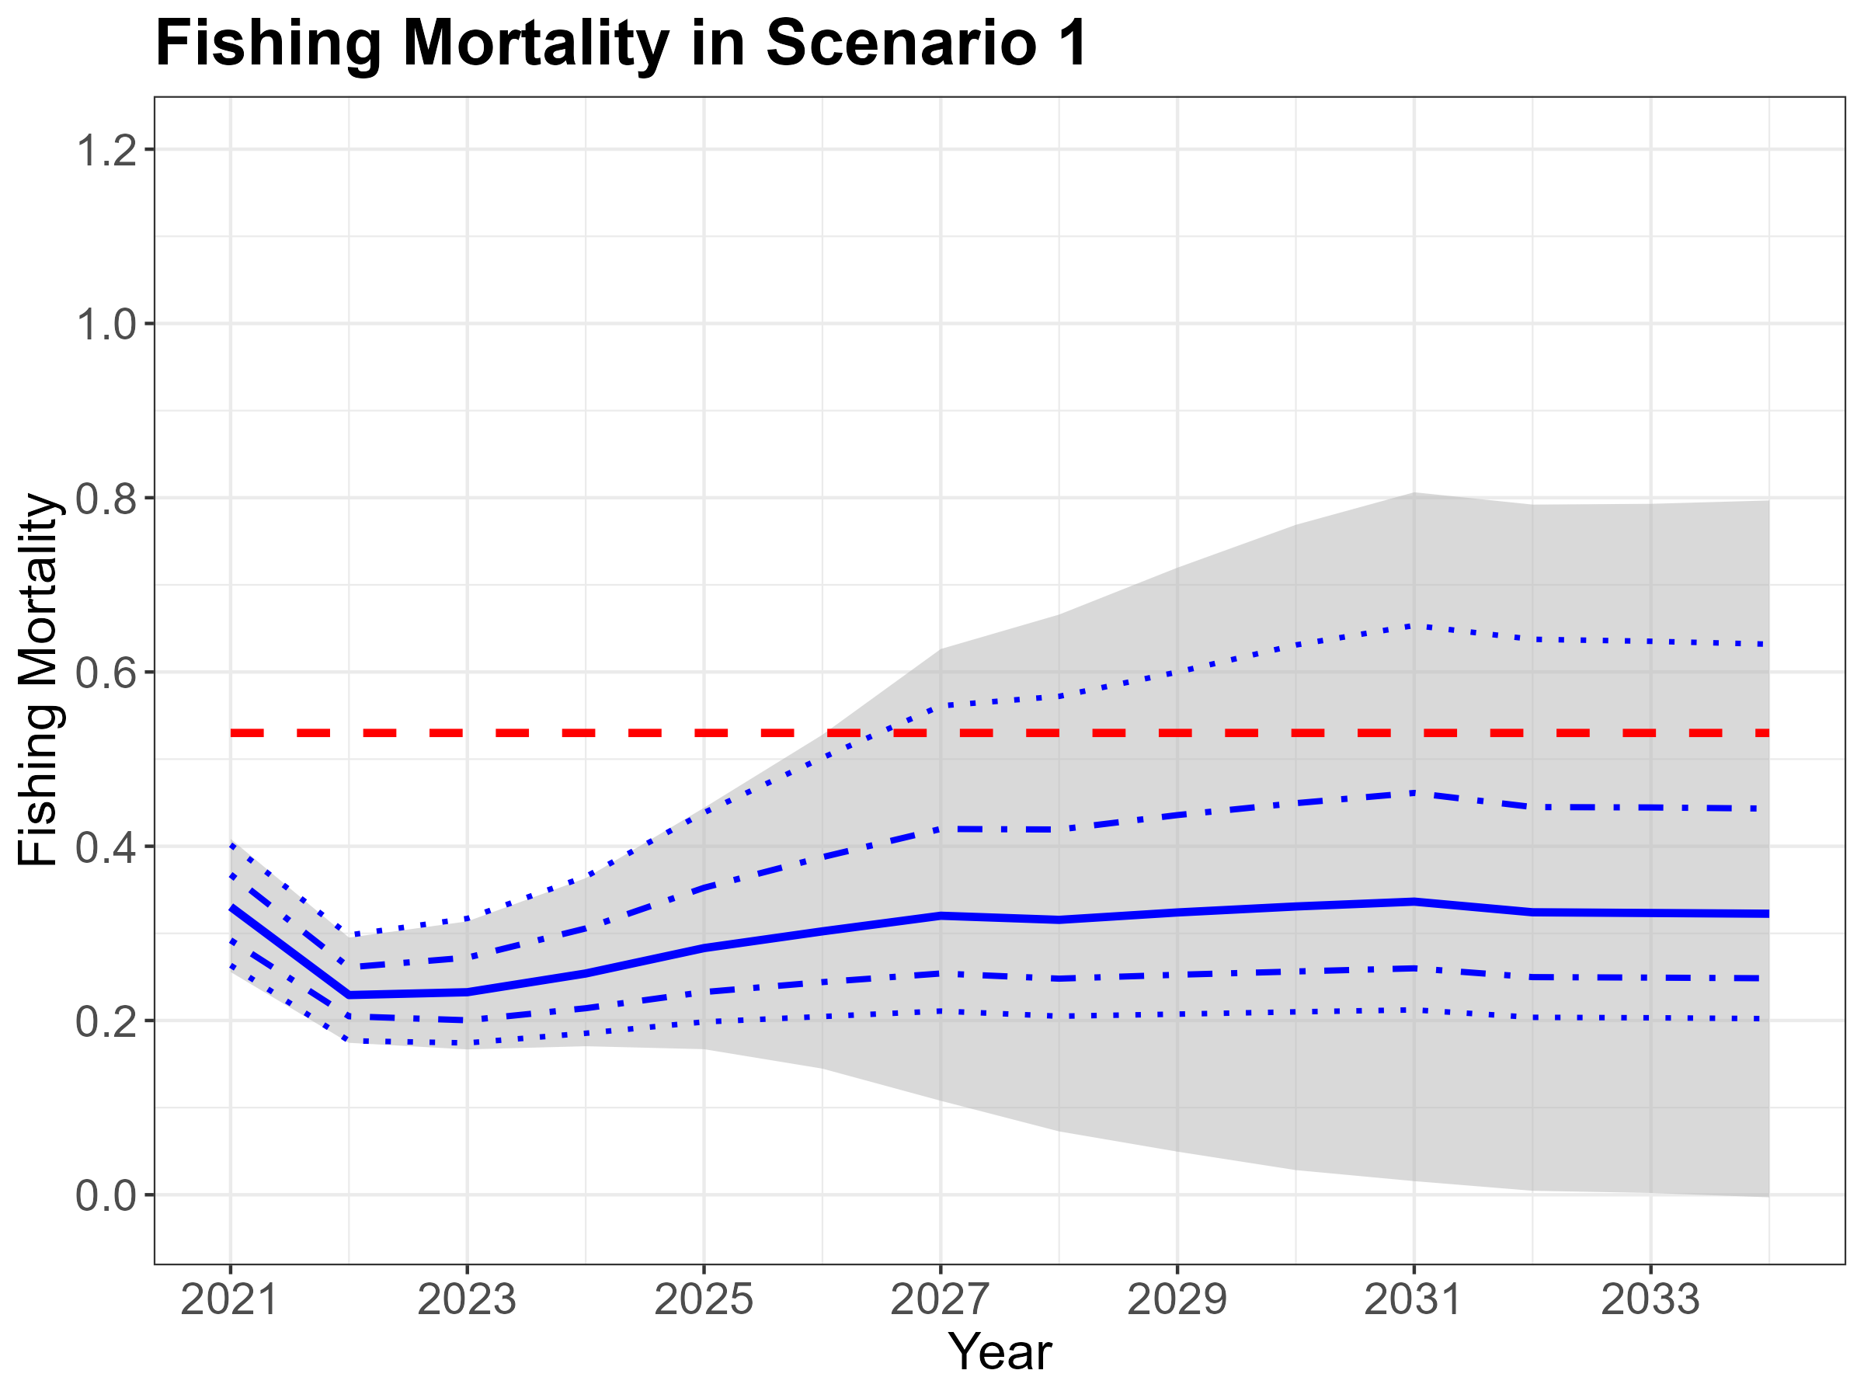

Slide 22
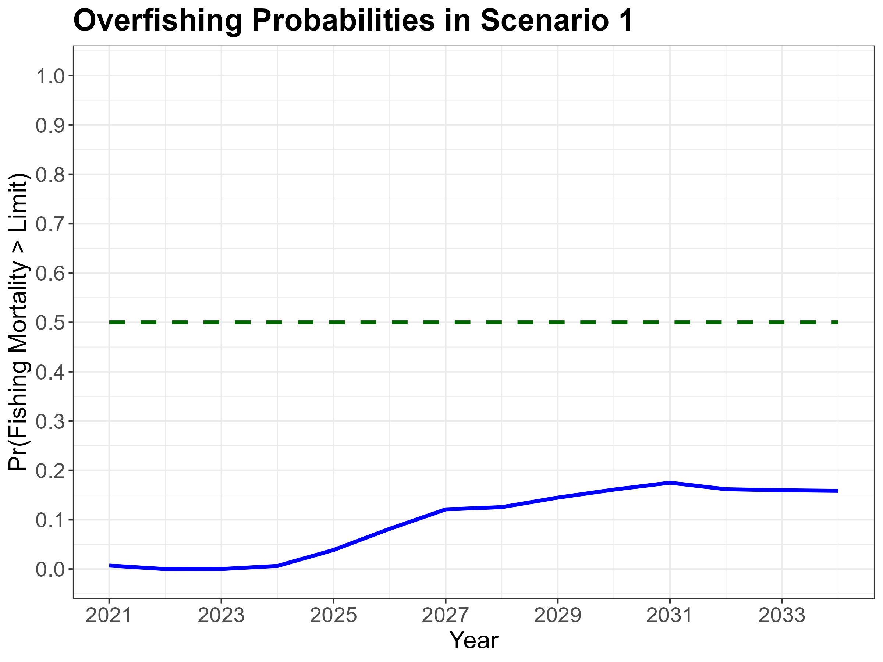

Slide 23
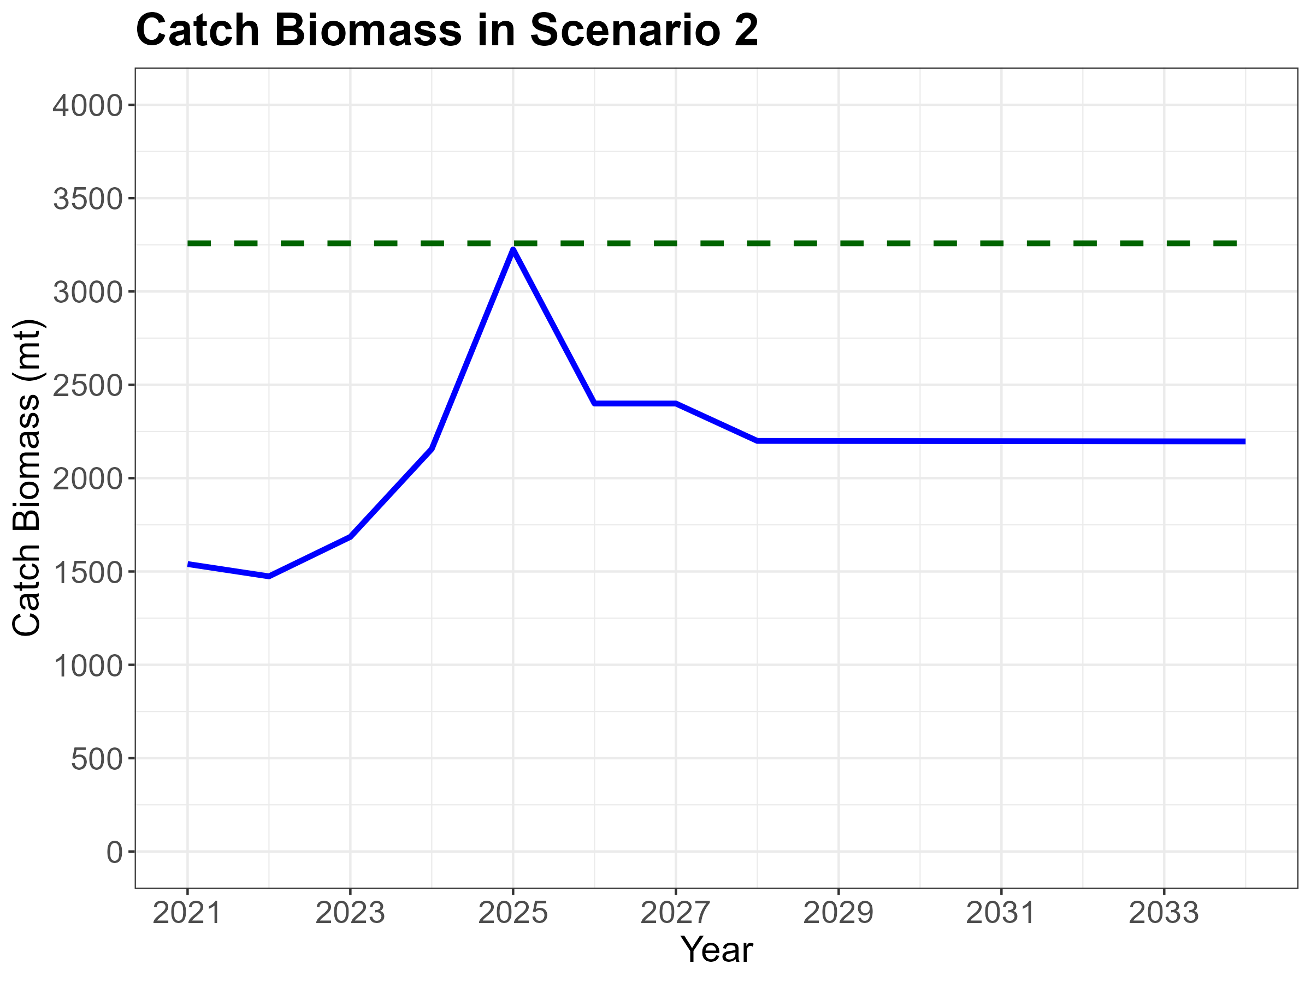

Slide 24
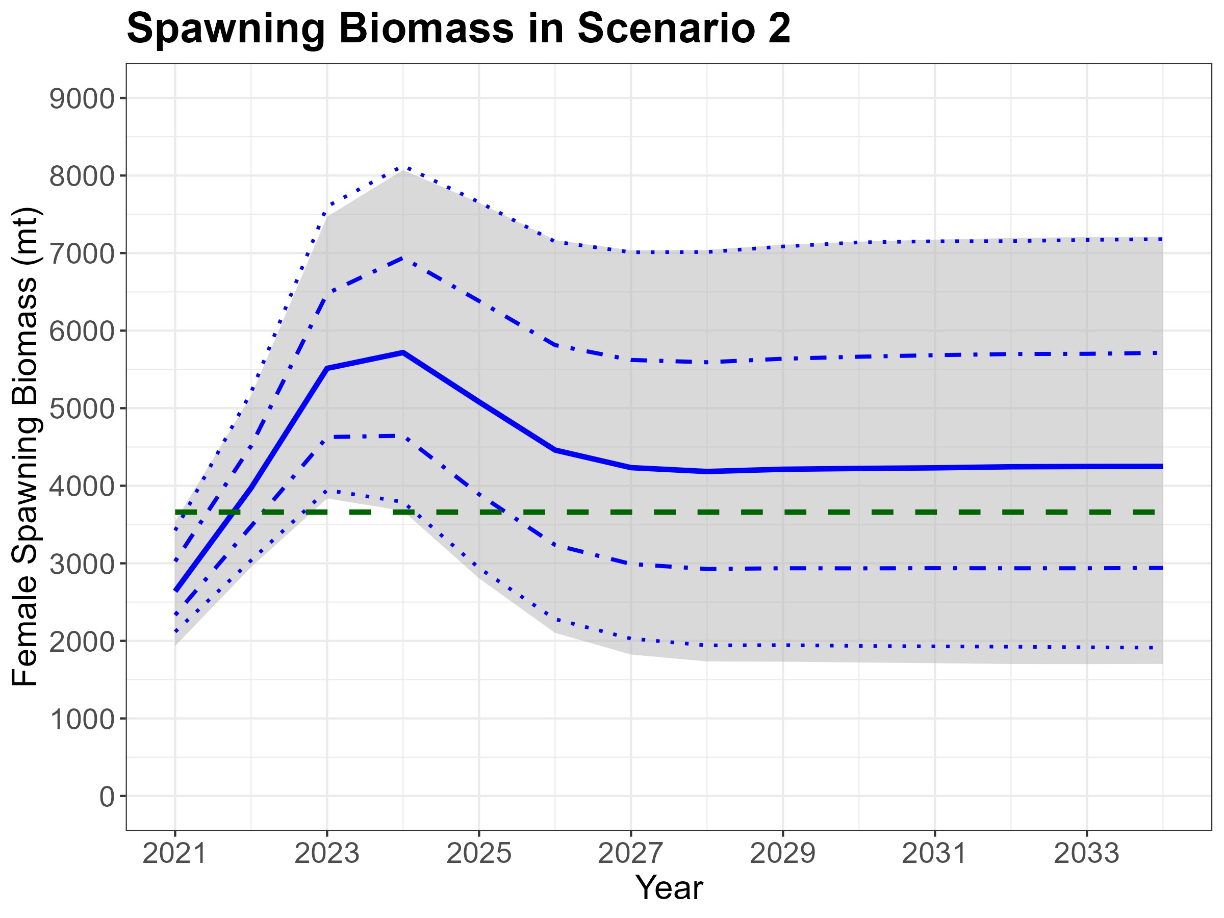

Slide 25
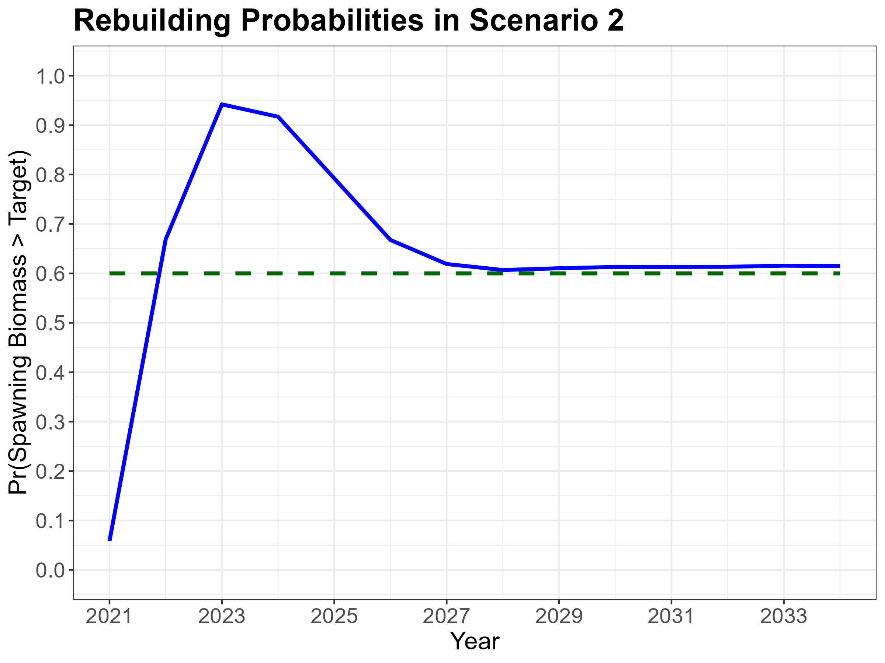

Slide 26
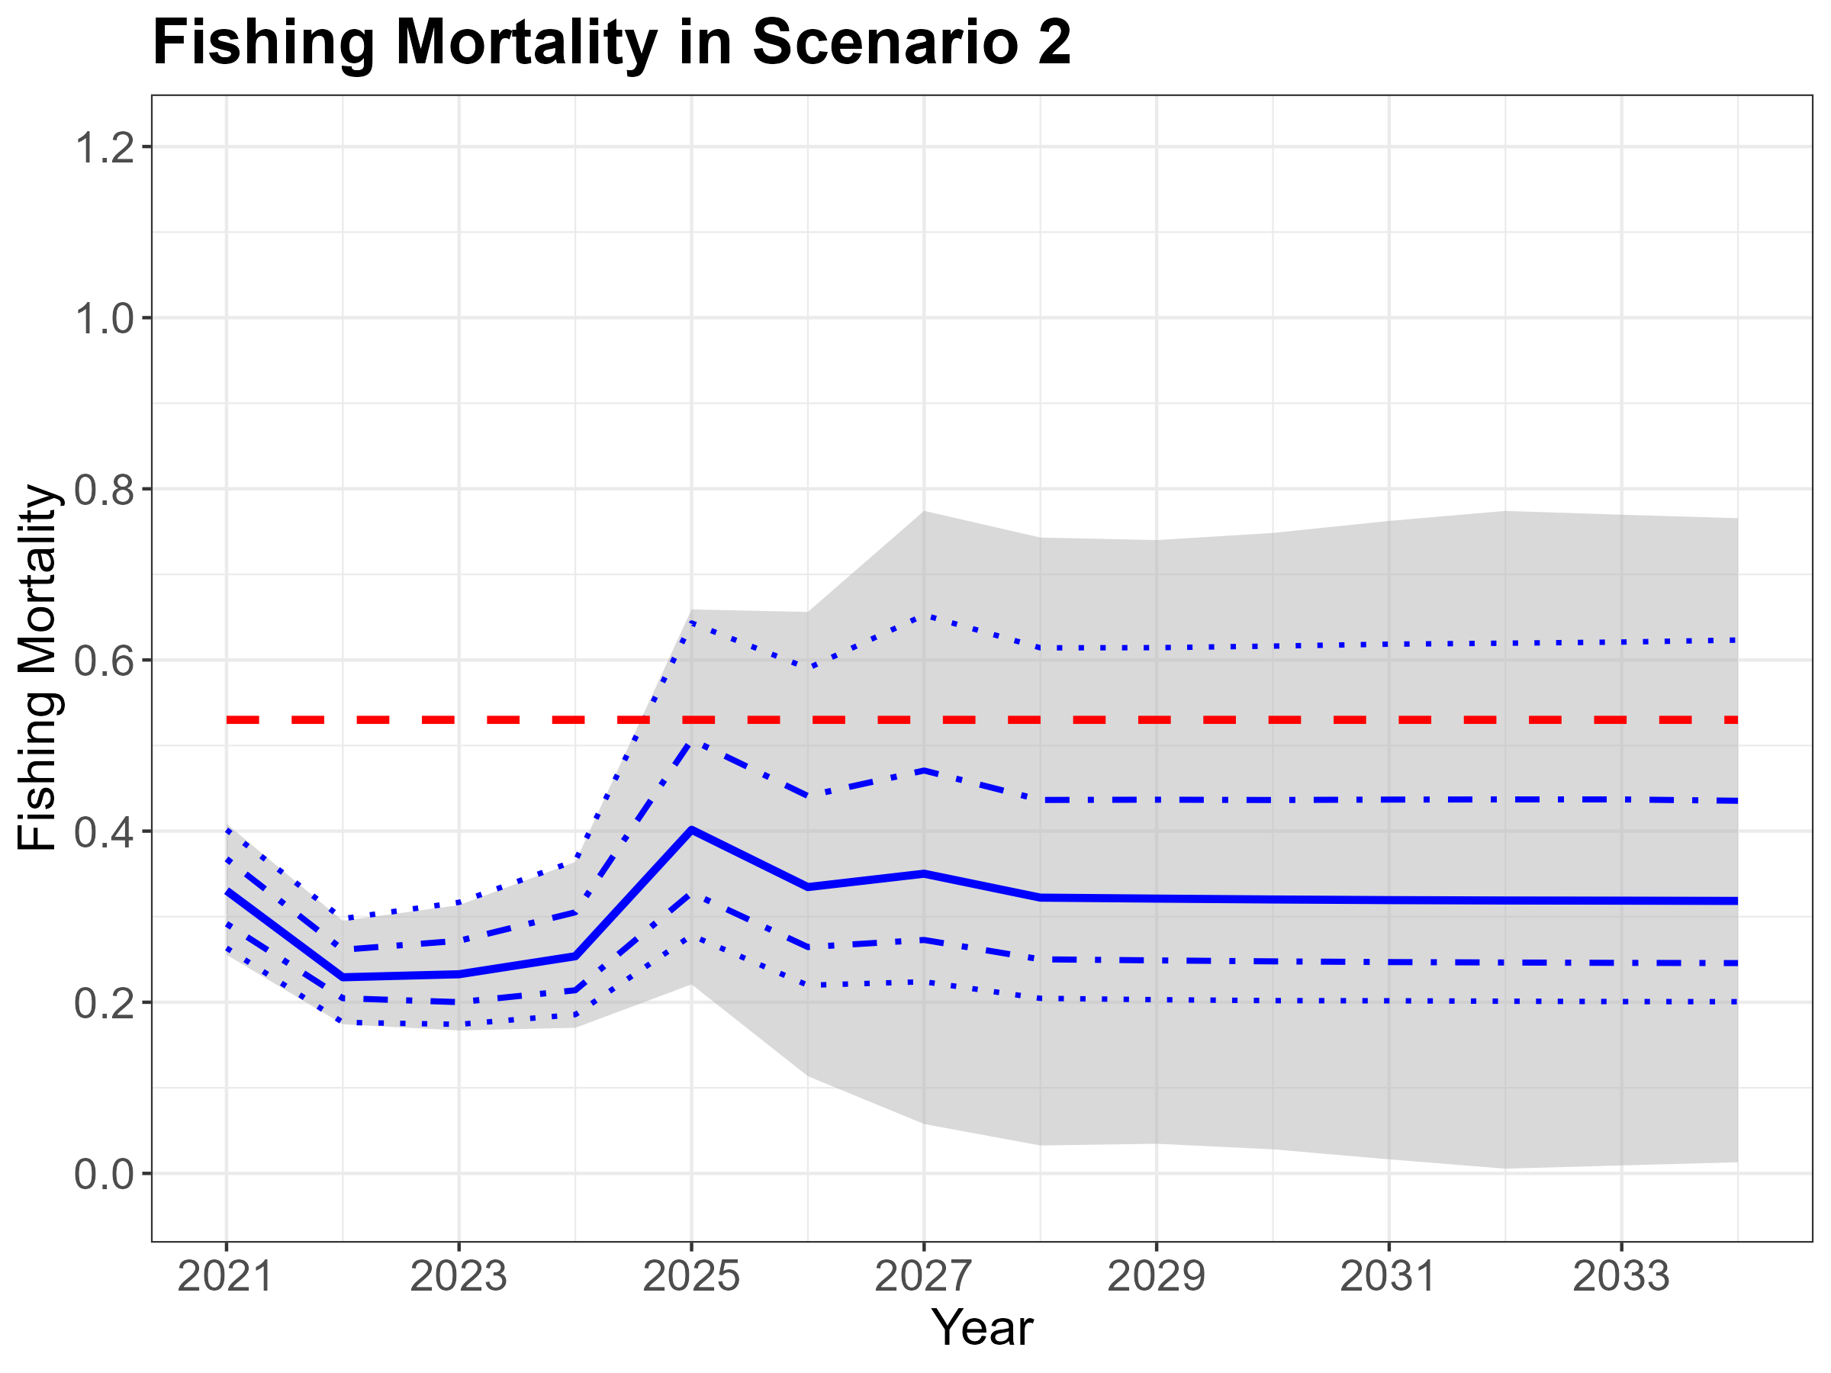

Slide 27
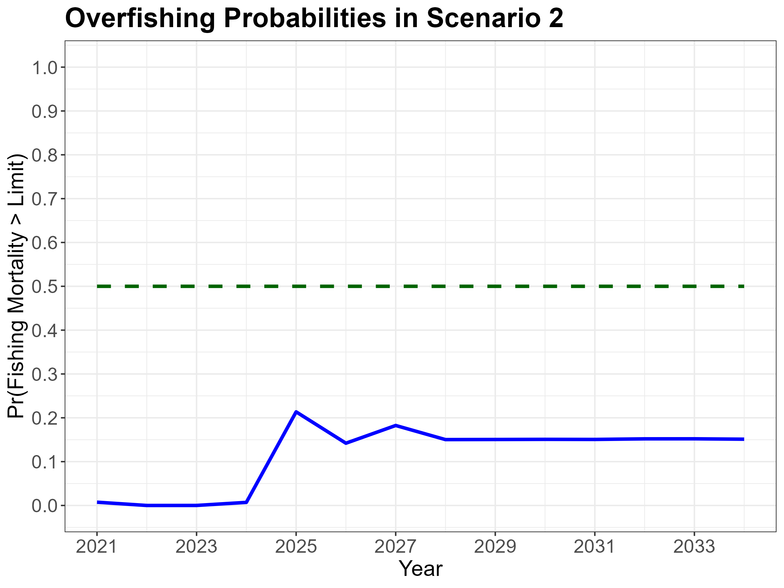

Slide 28
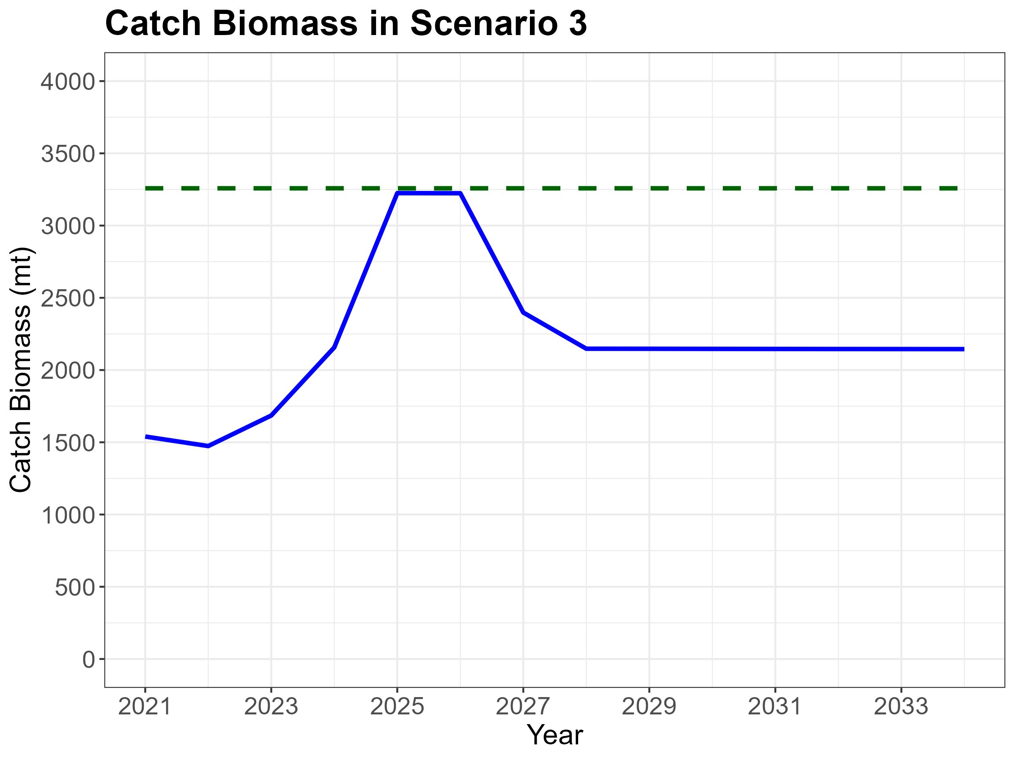

Slide 29
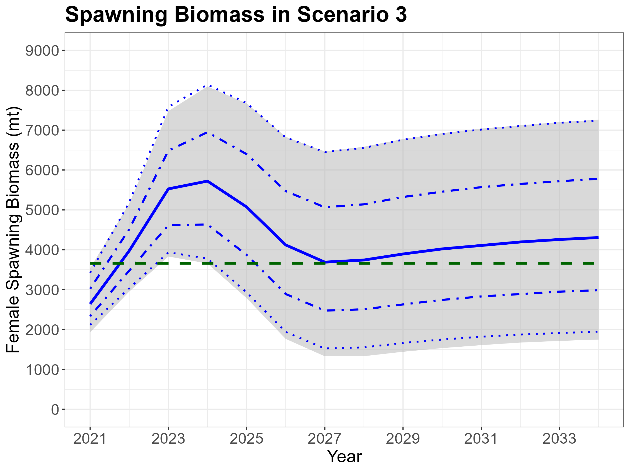

Slide 30
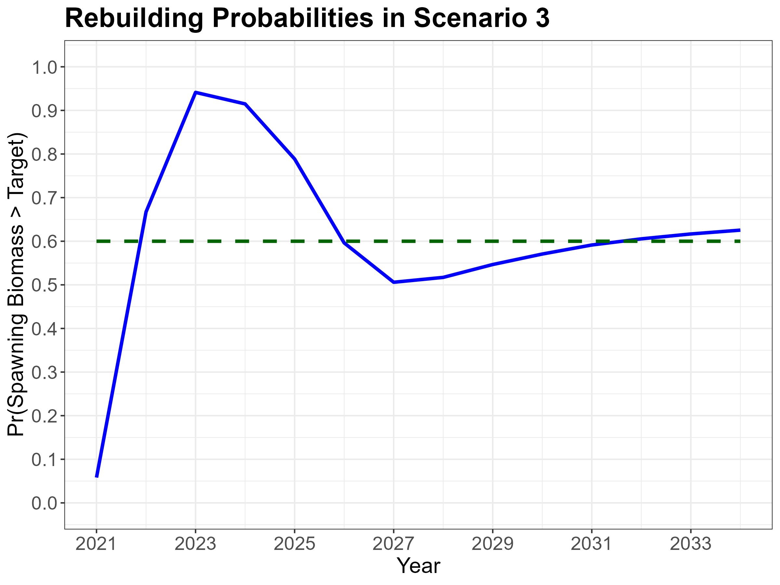

Slide 31
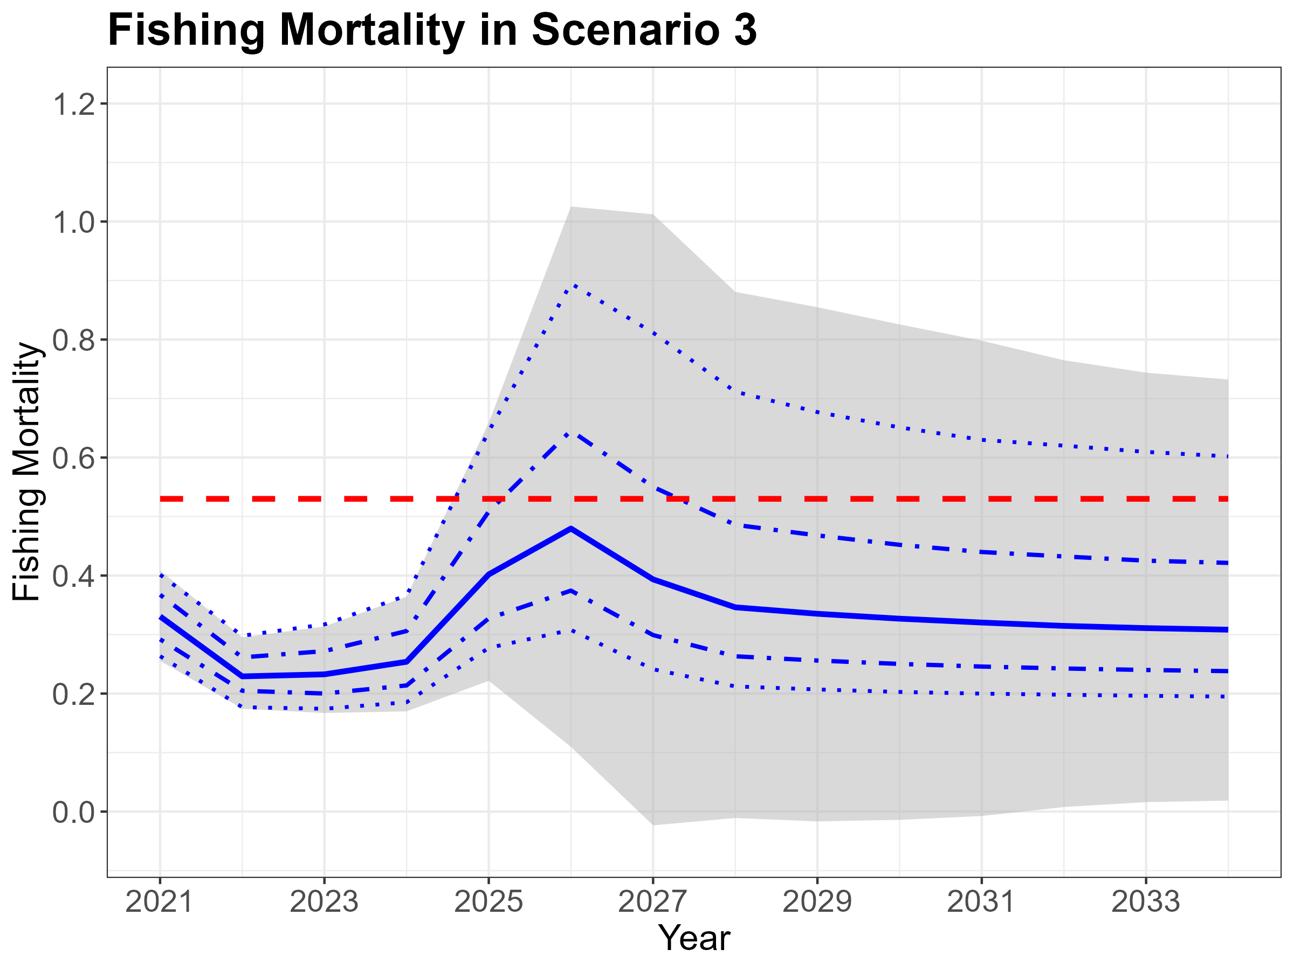

Slide 32
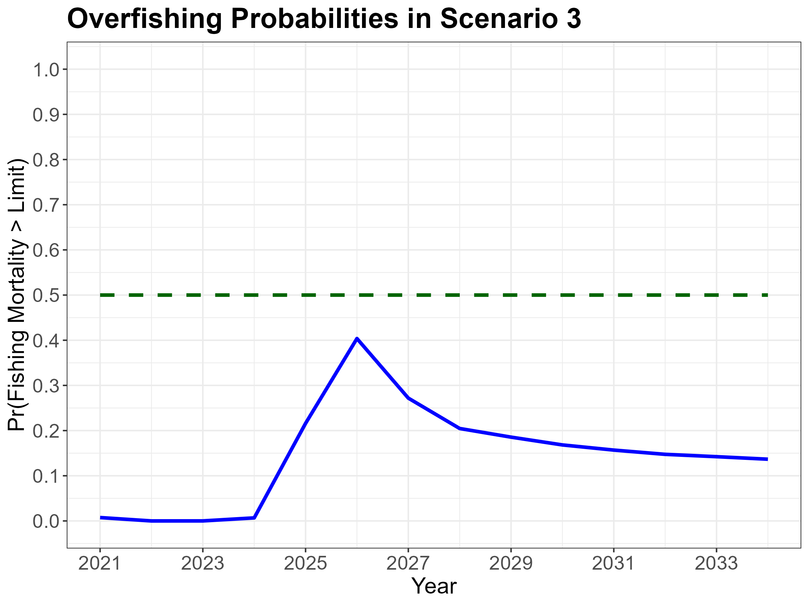

Slide 33
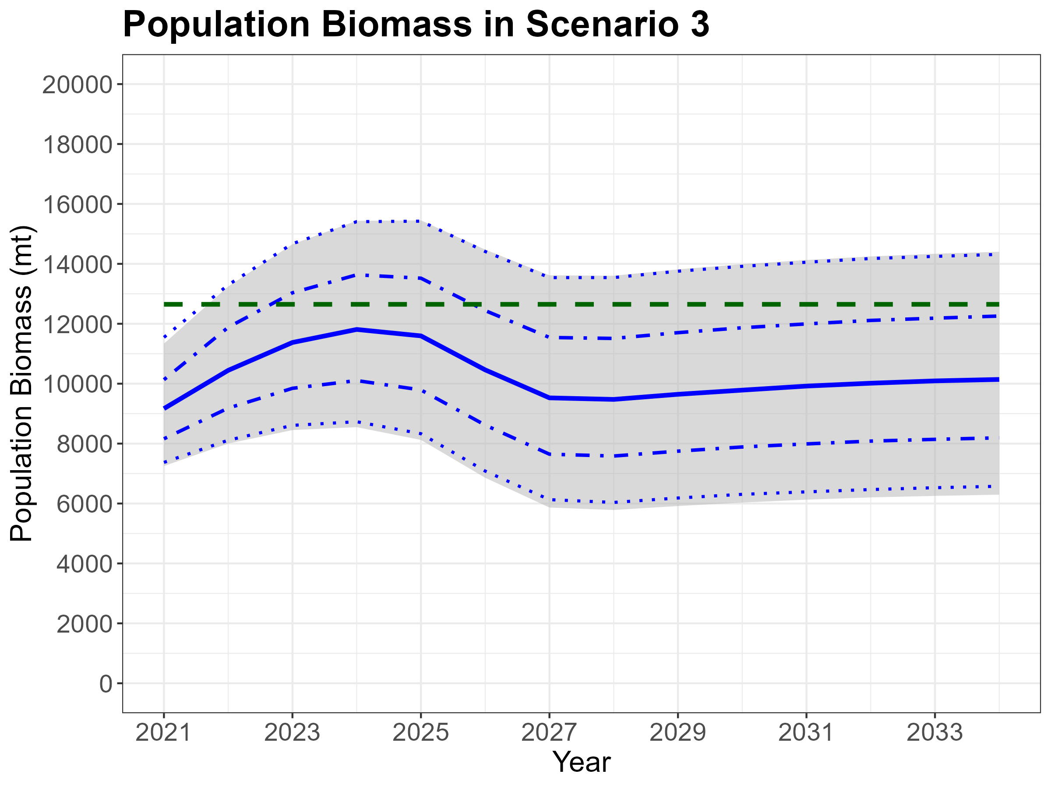

Slide 35



Slide 36


